Slide 2

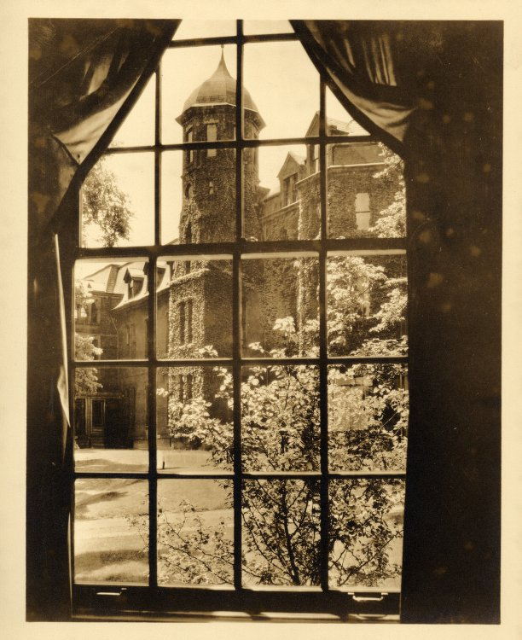
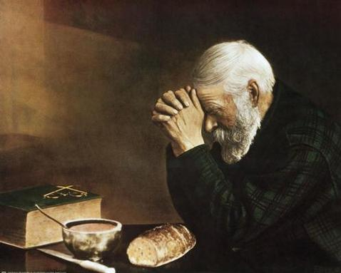
Beyond
Their
Windows

Slide 3
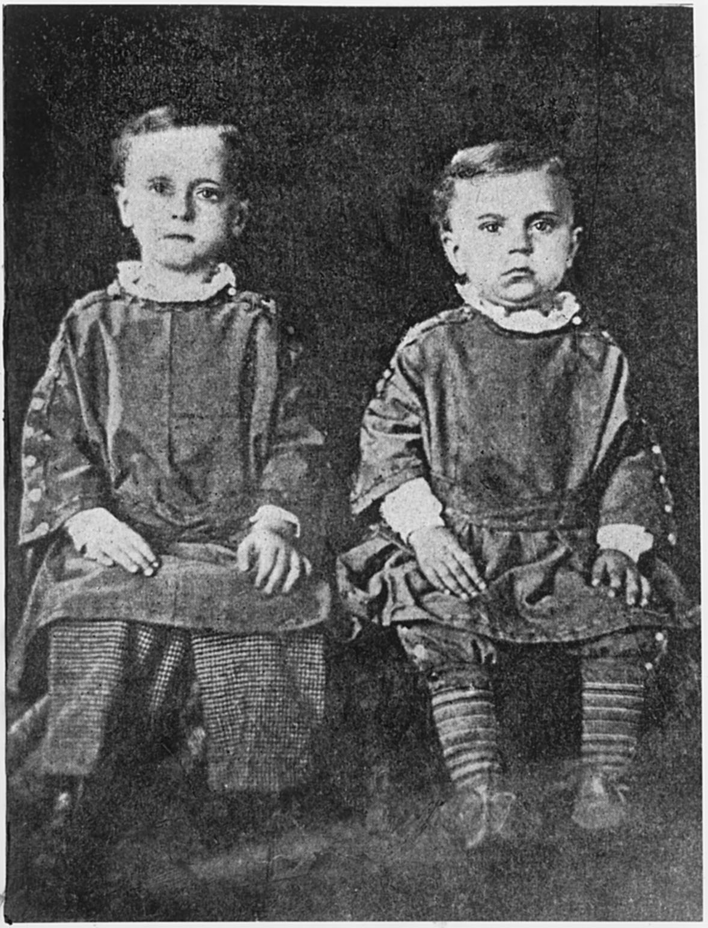
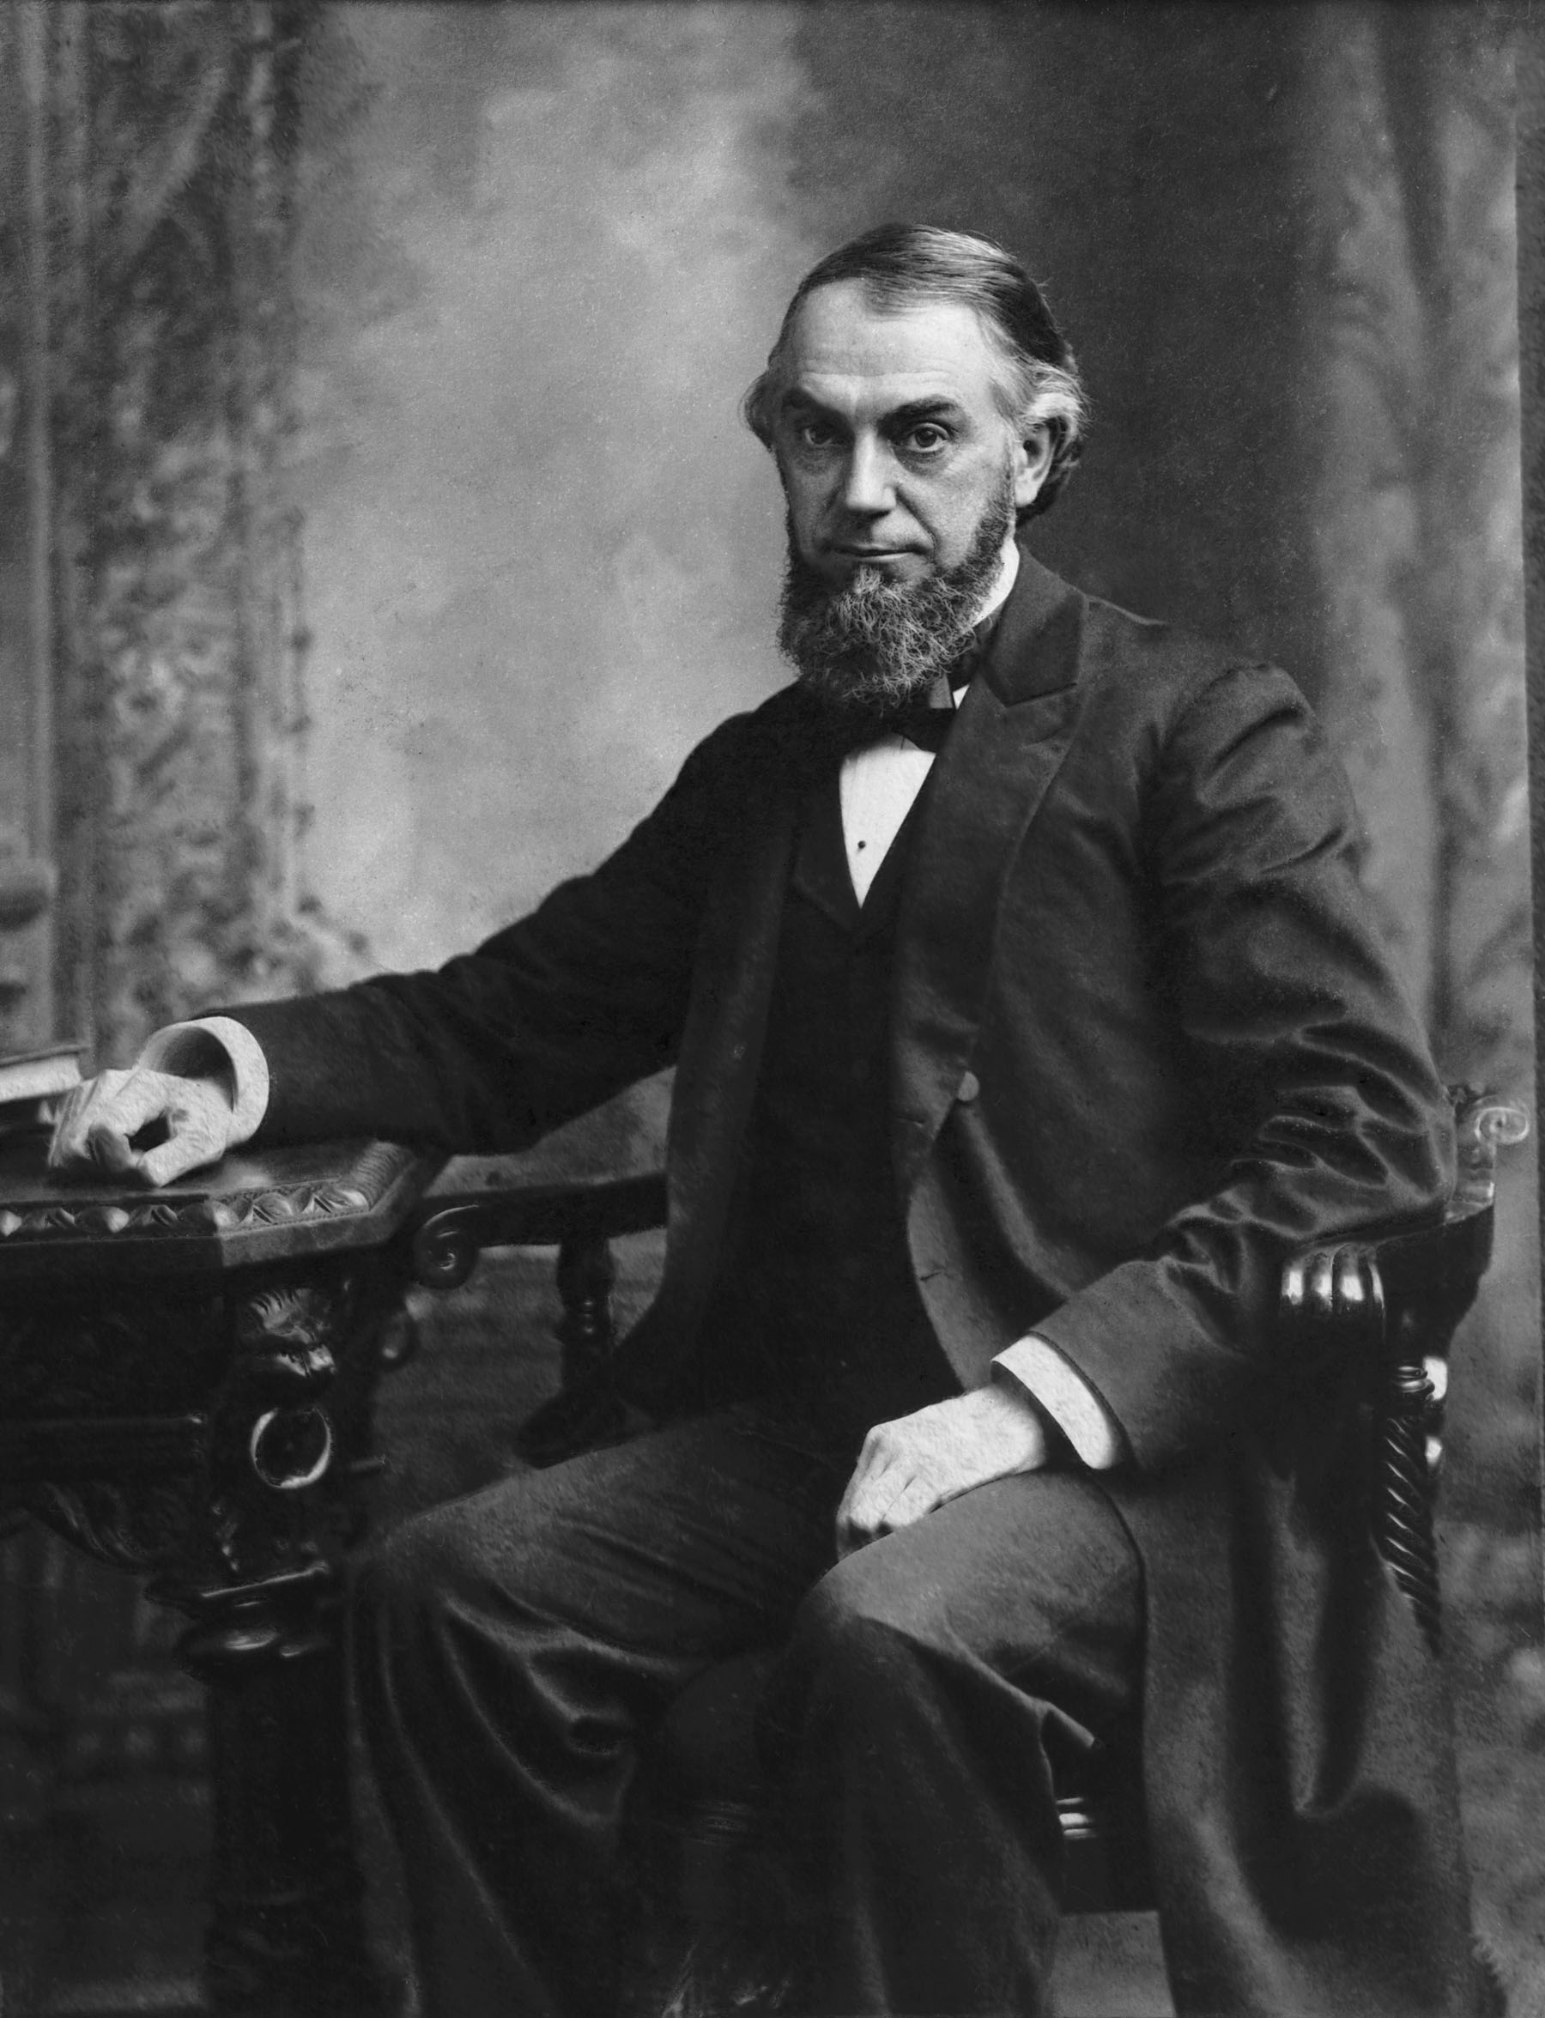
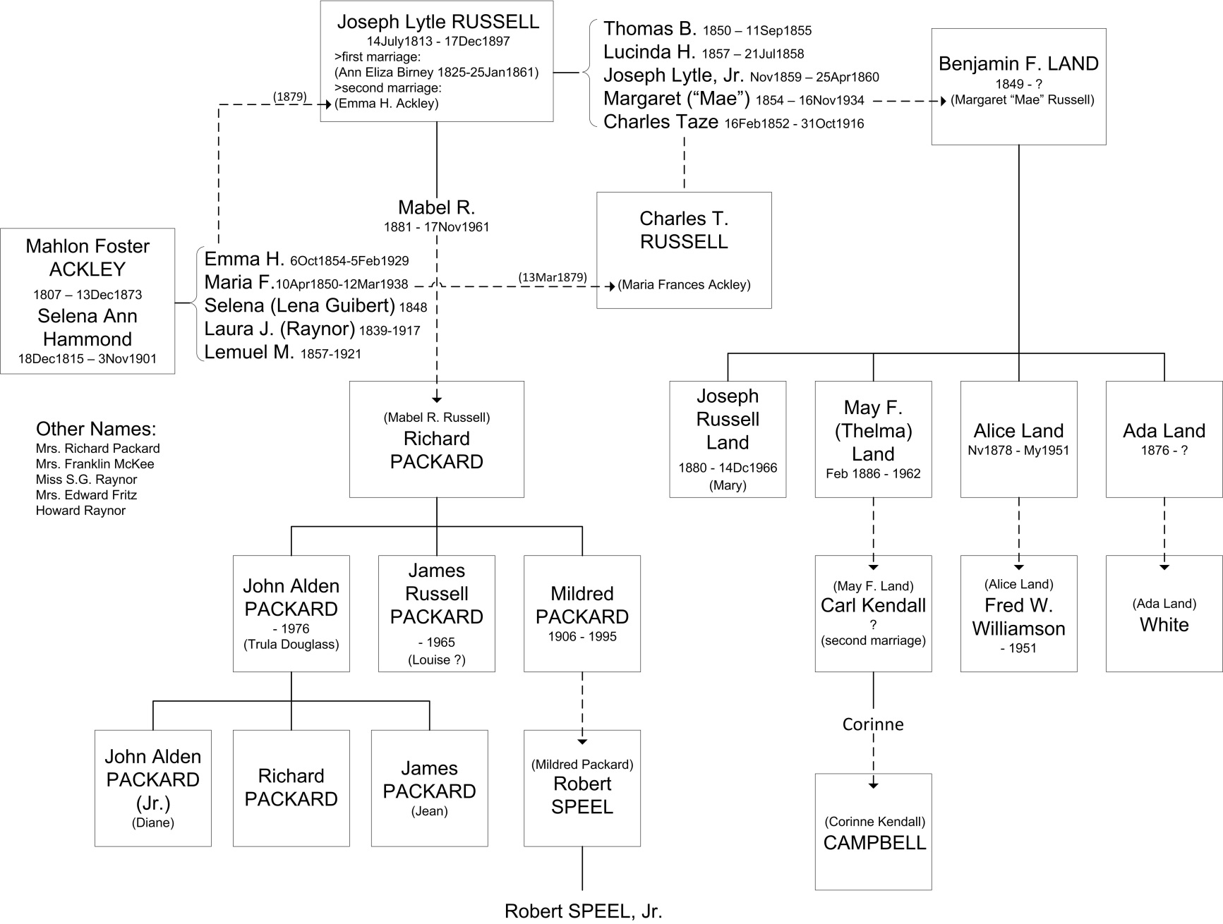

Slide 4
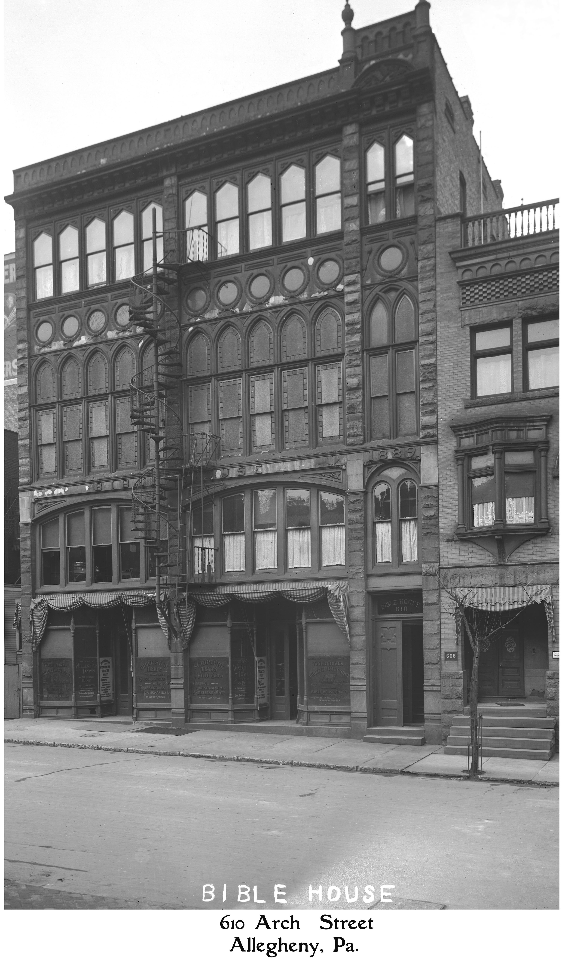
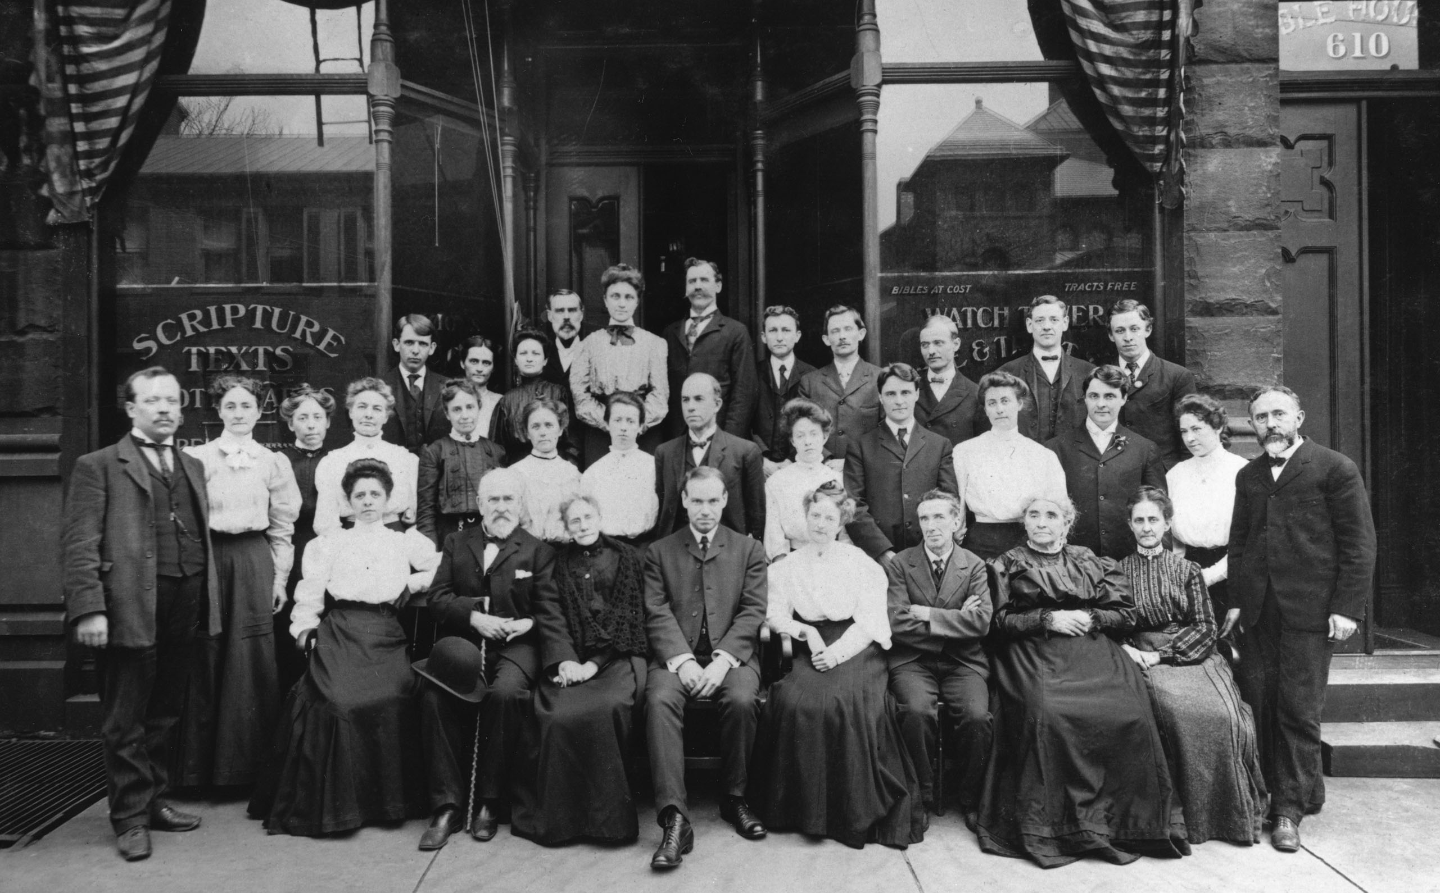

Slide 5
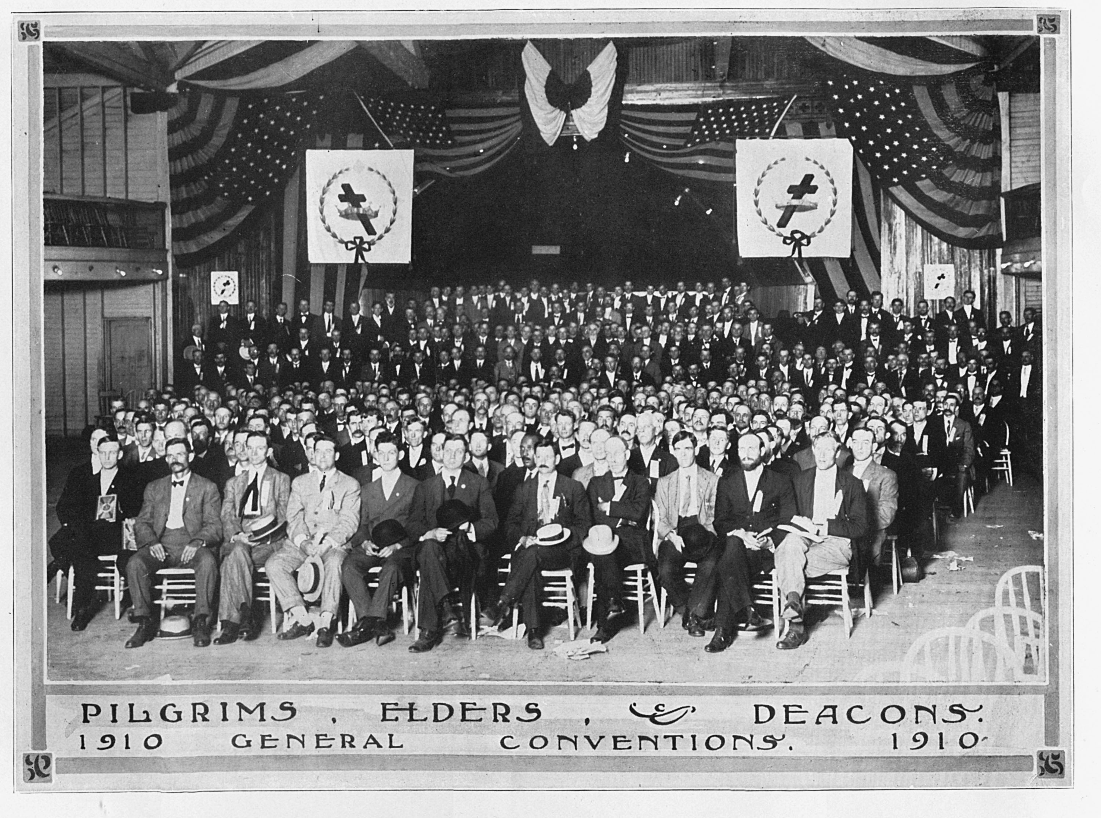
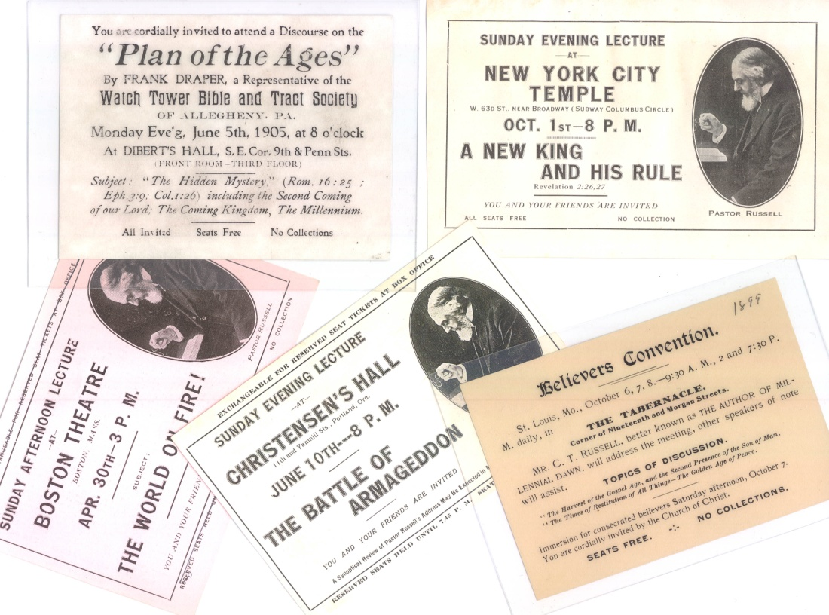
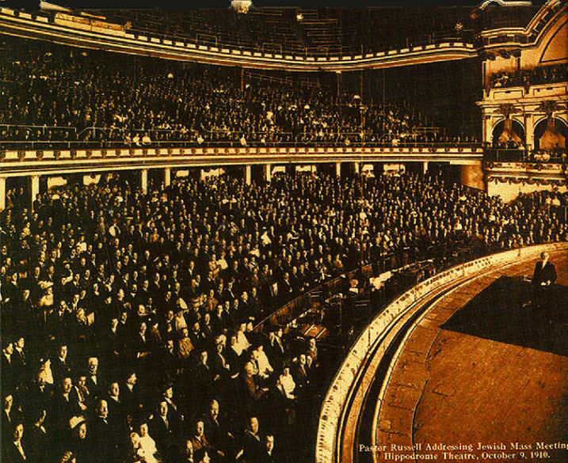
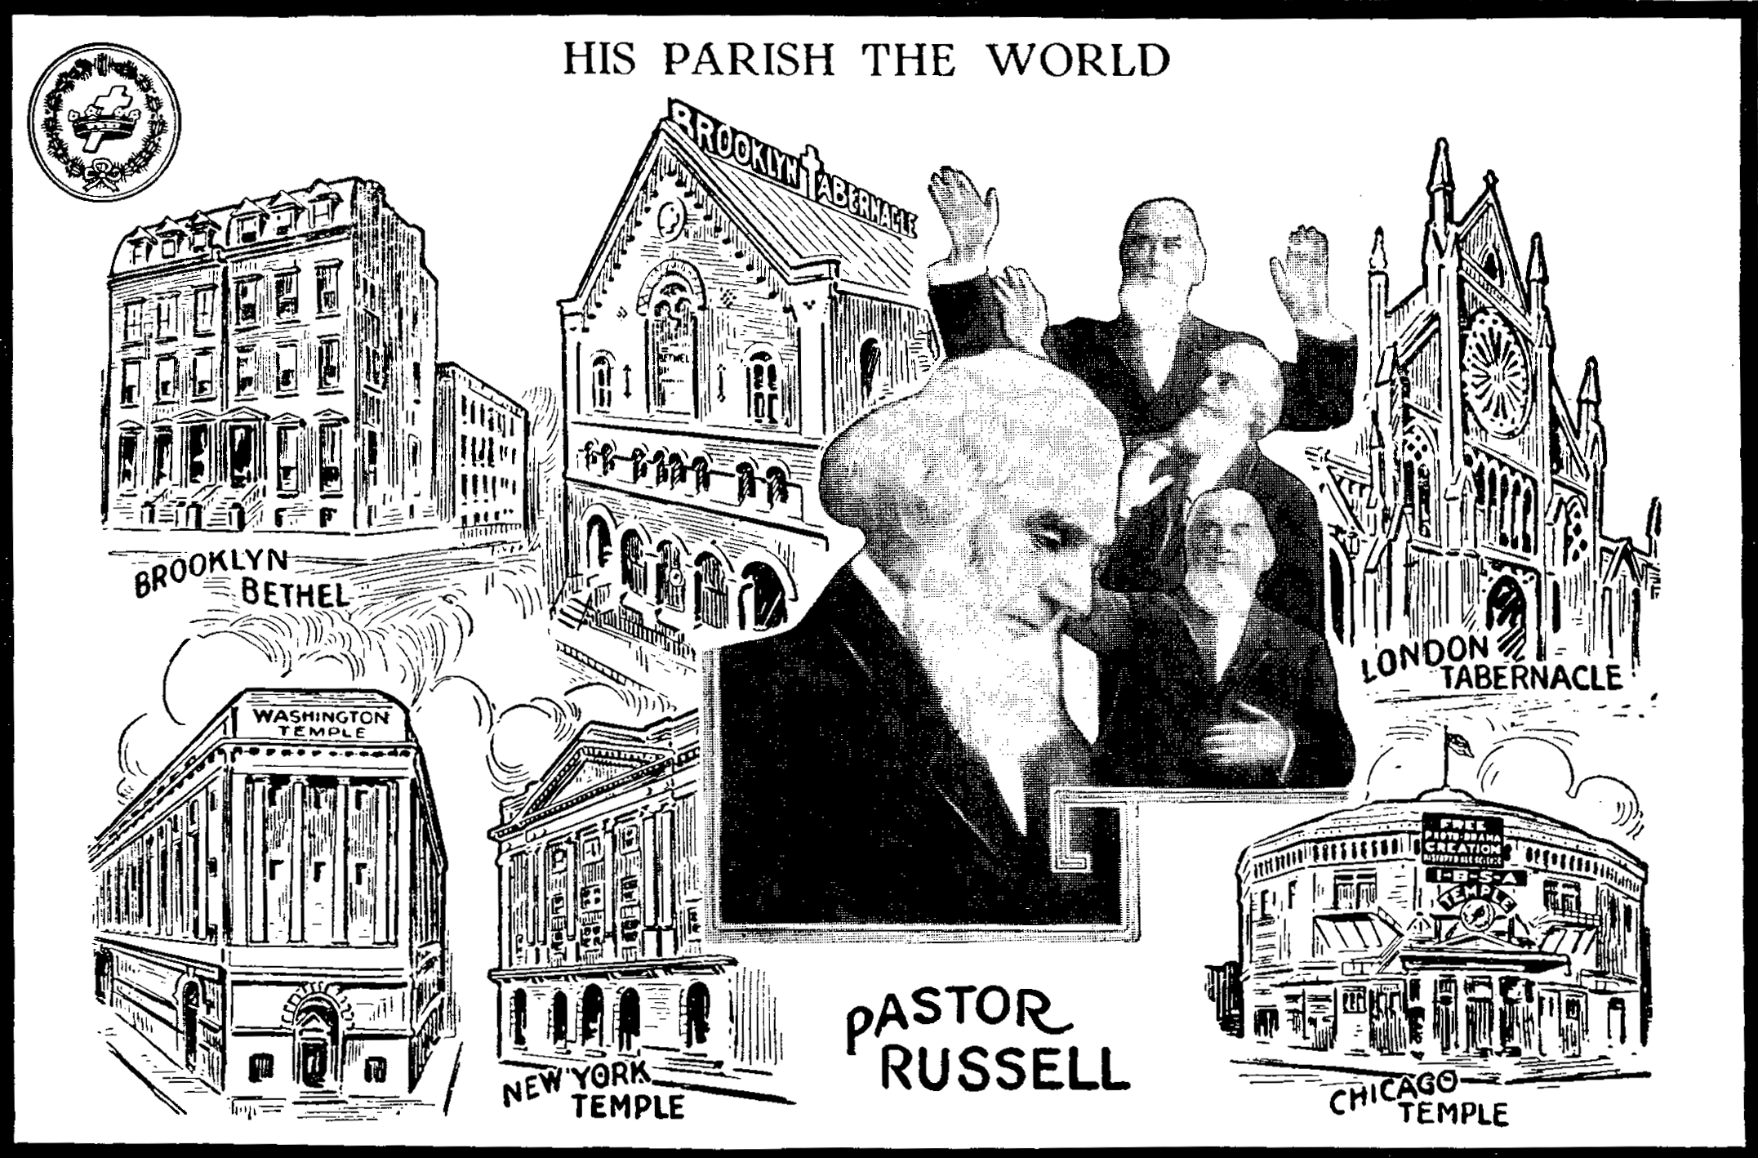

Slide 6

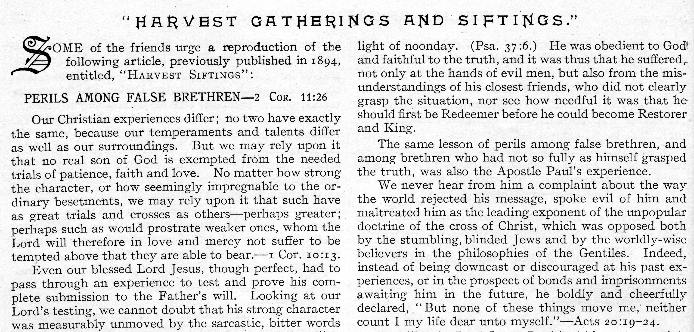
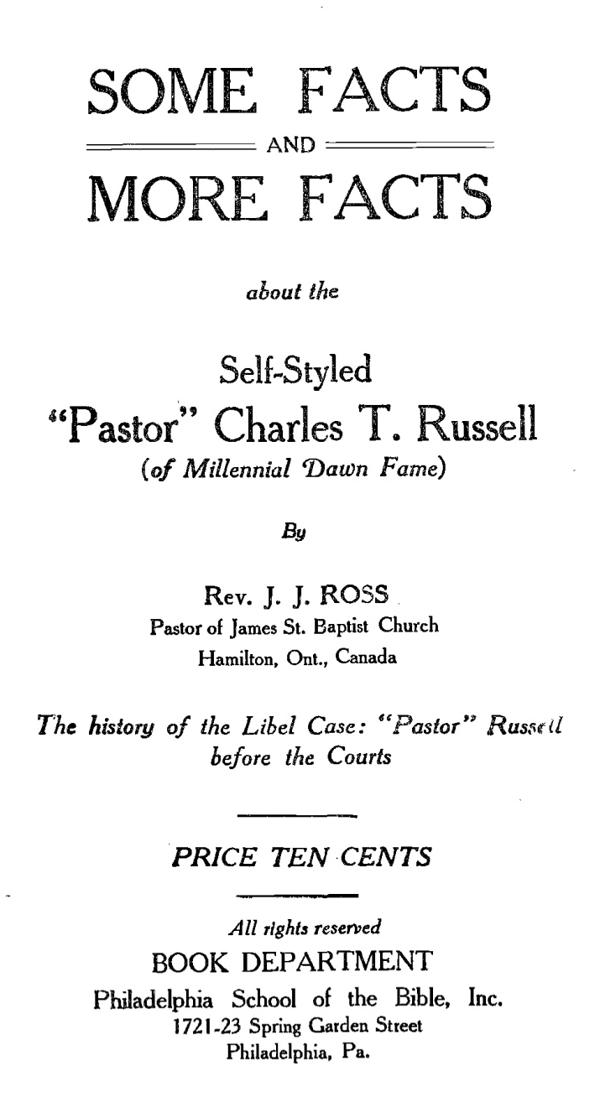

?

Slide 7
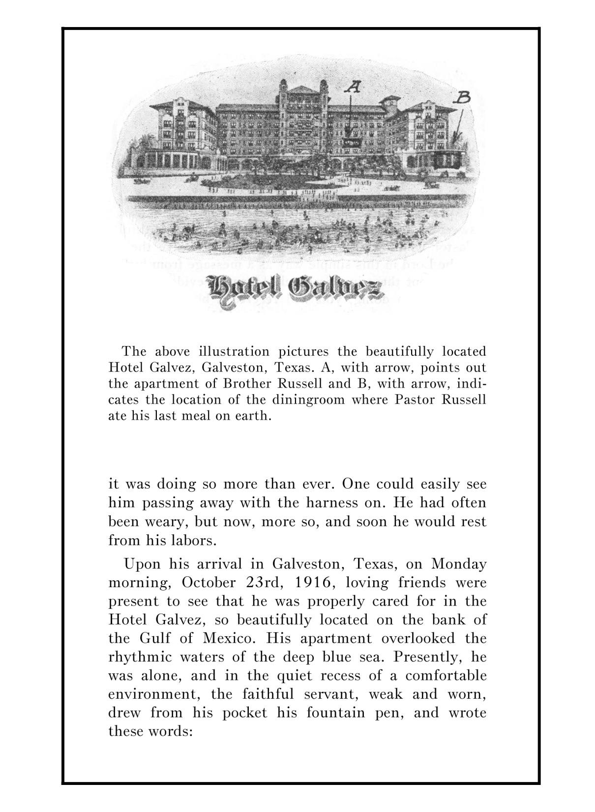
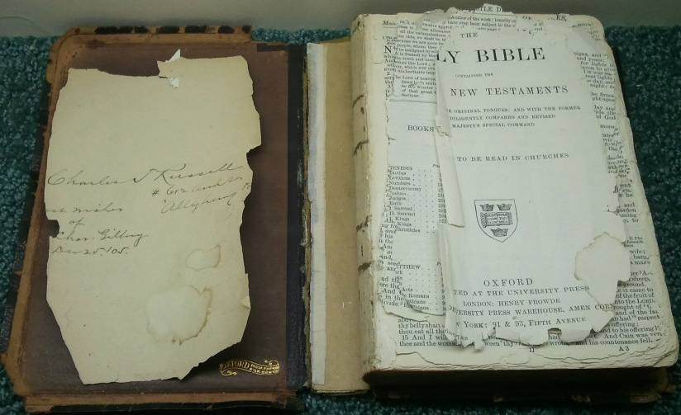
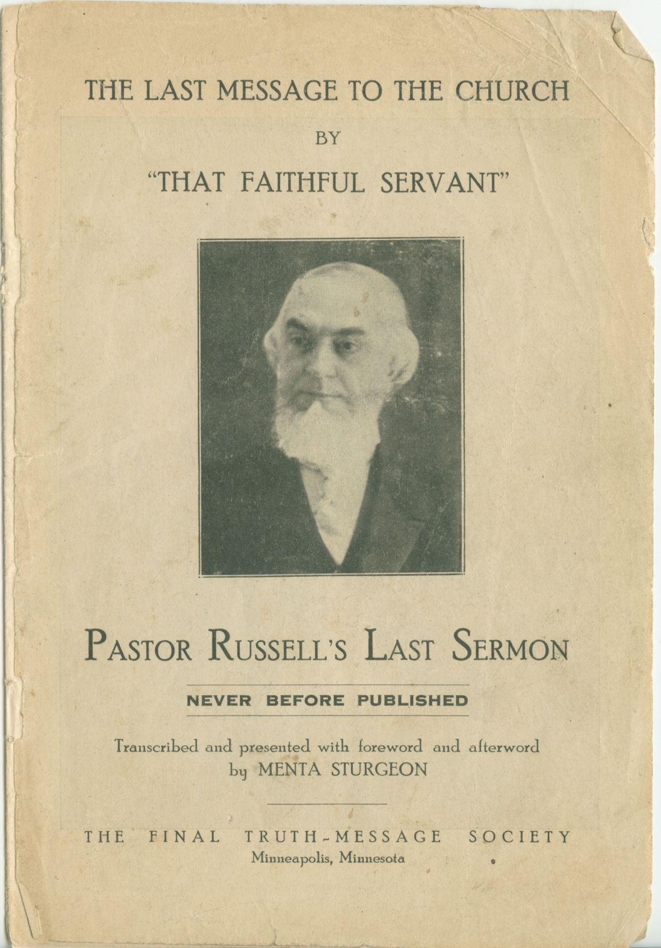
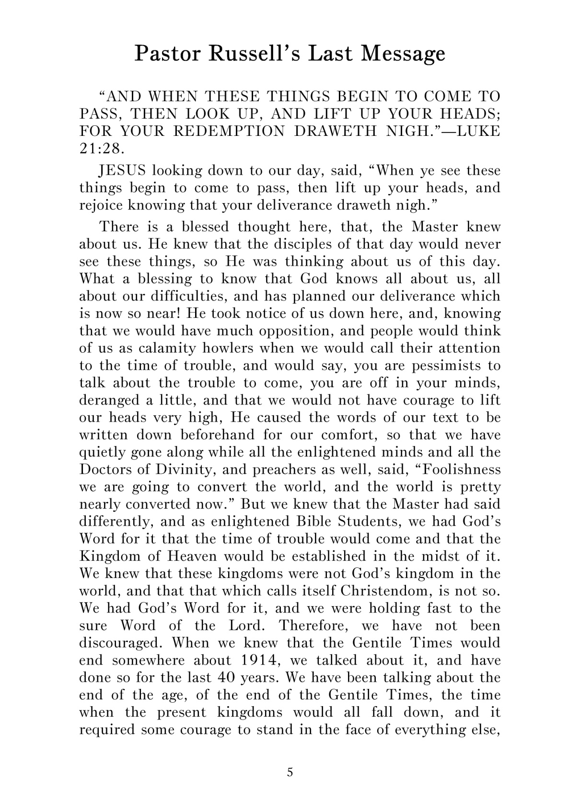
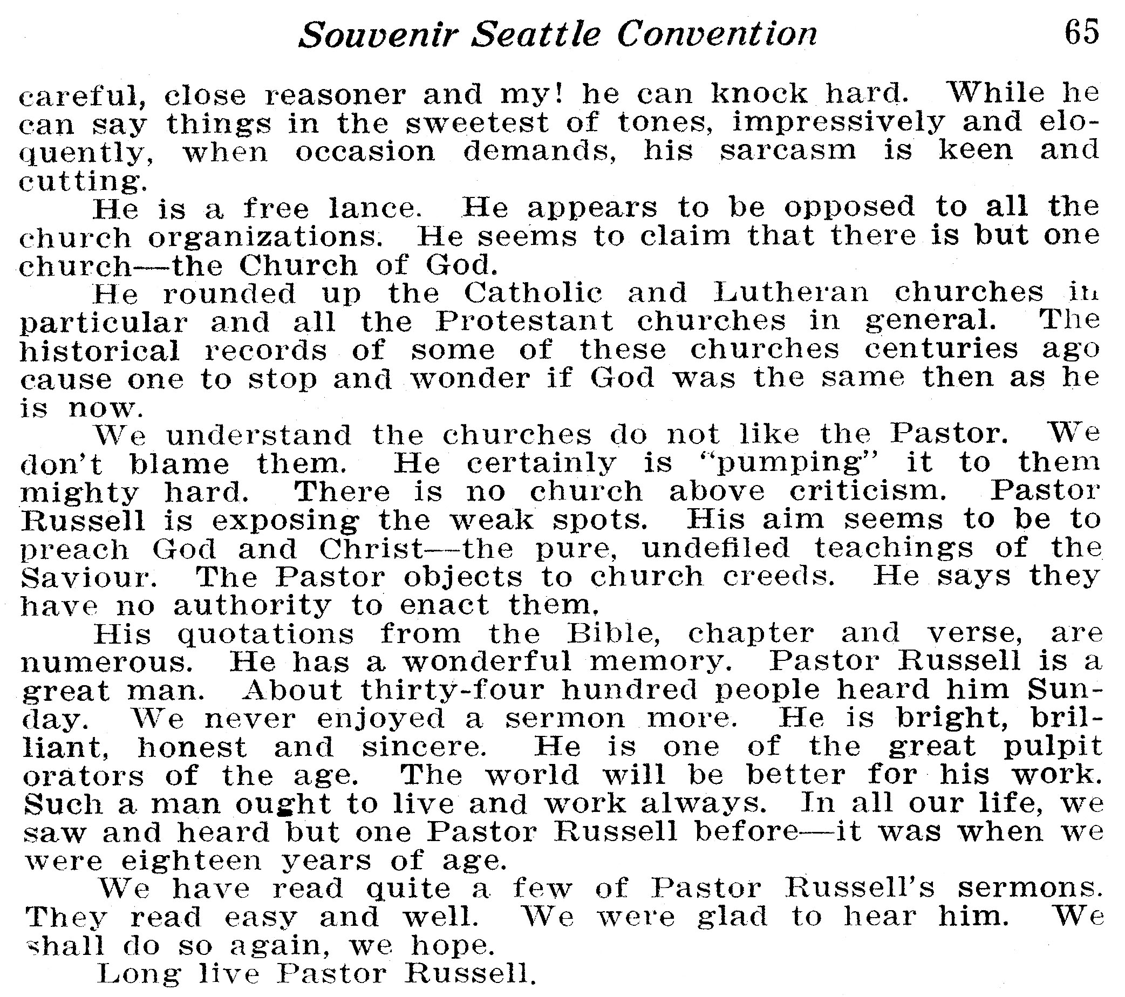
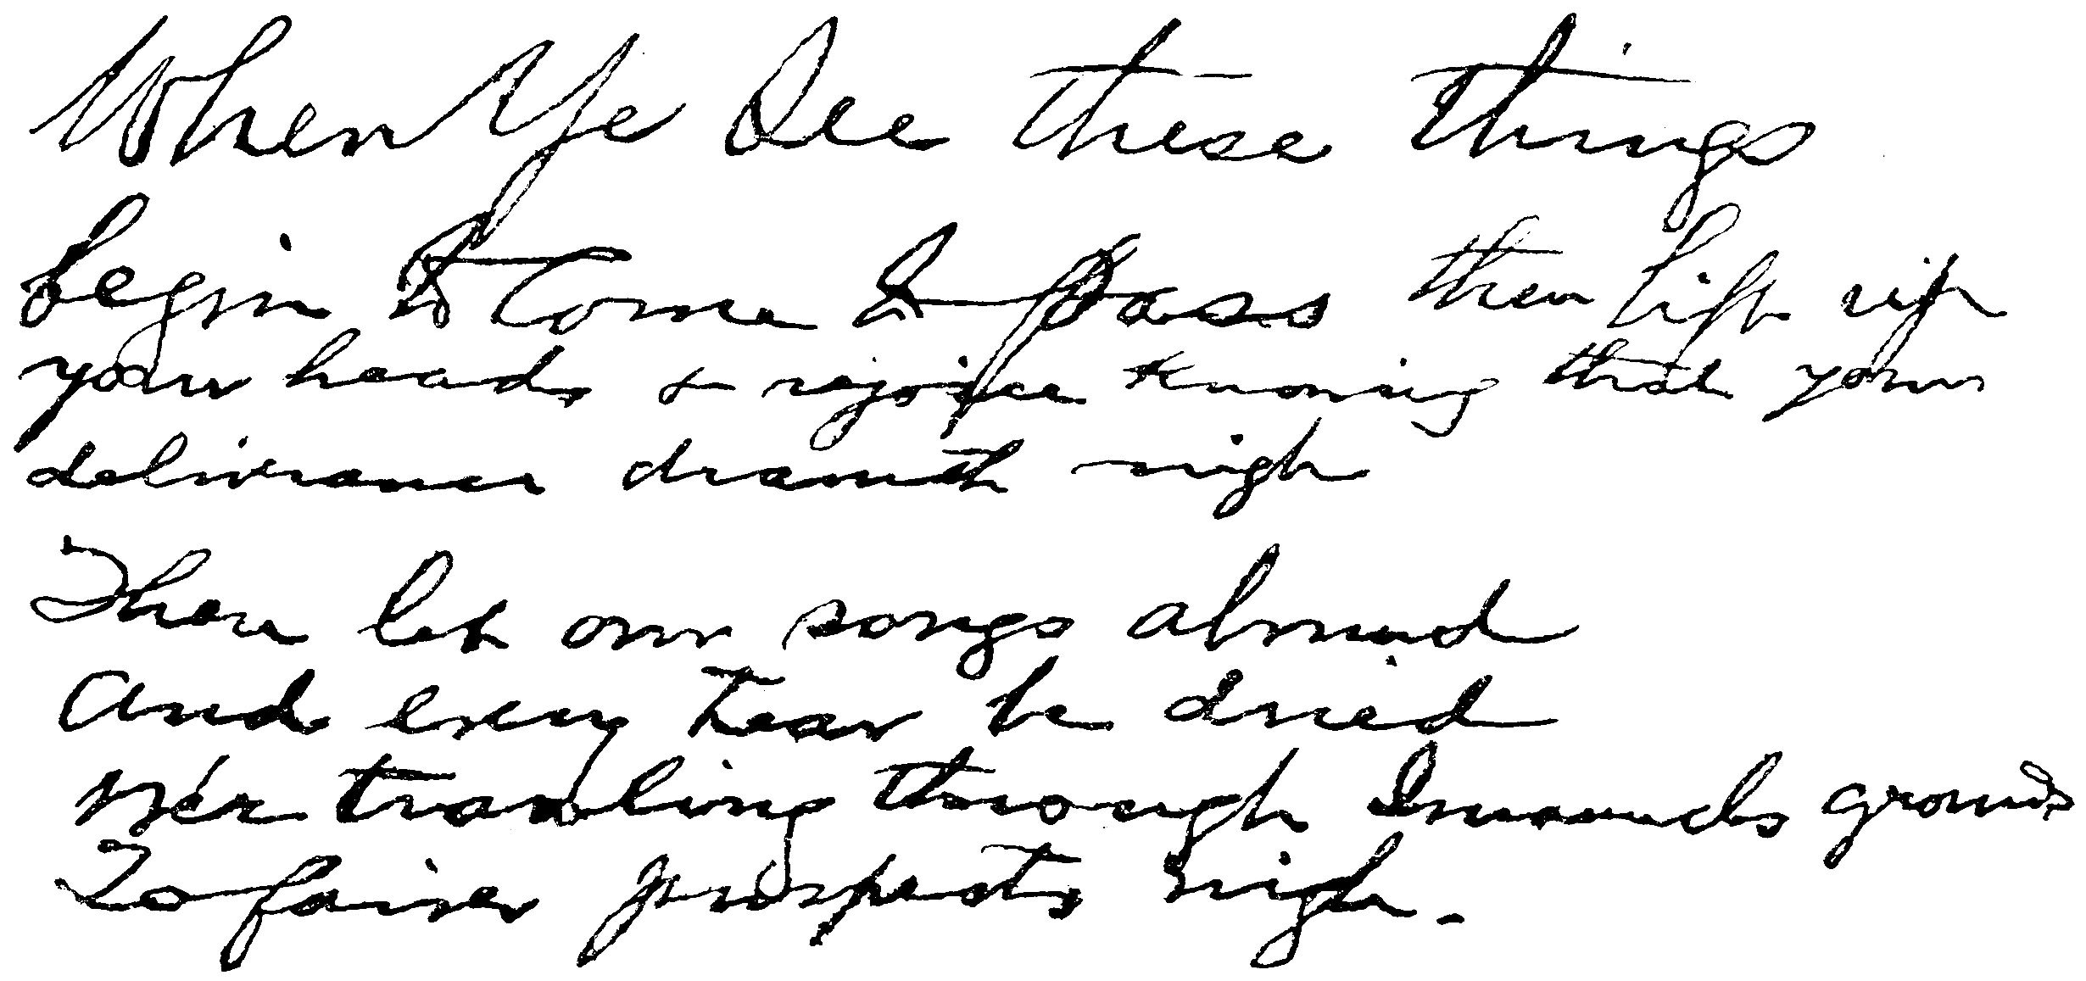
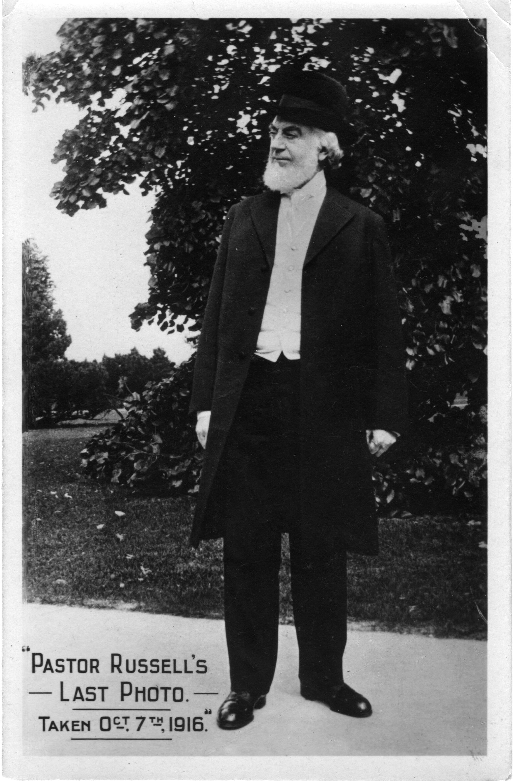
September 14-17, 1916

Slide 8
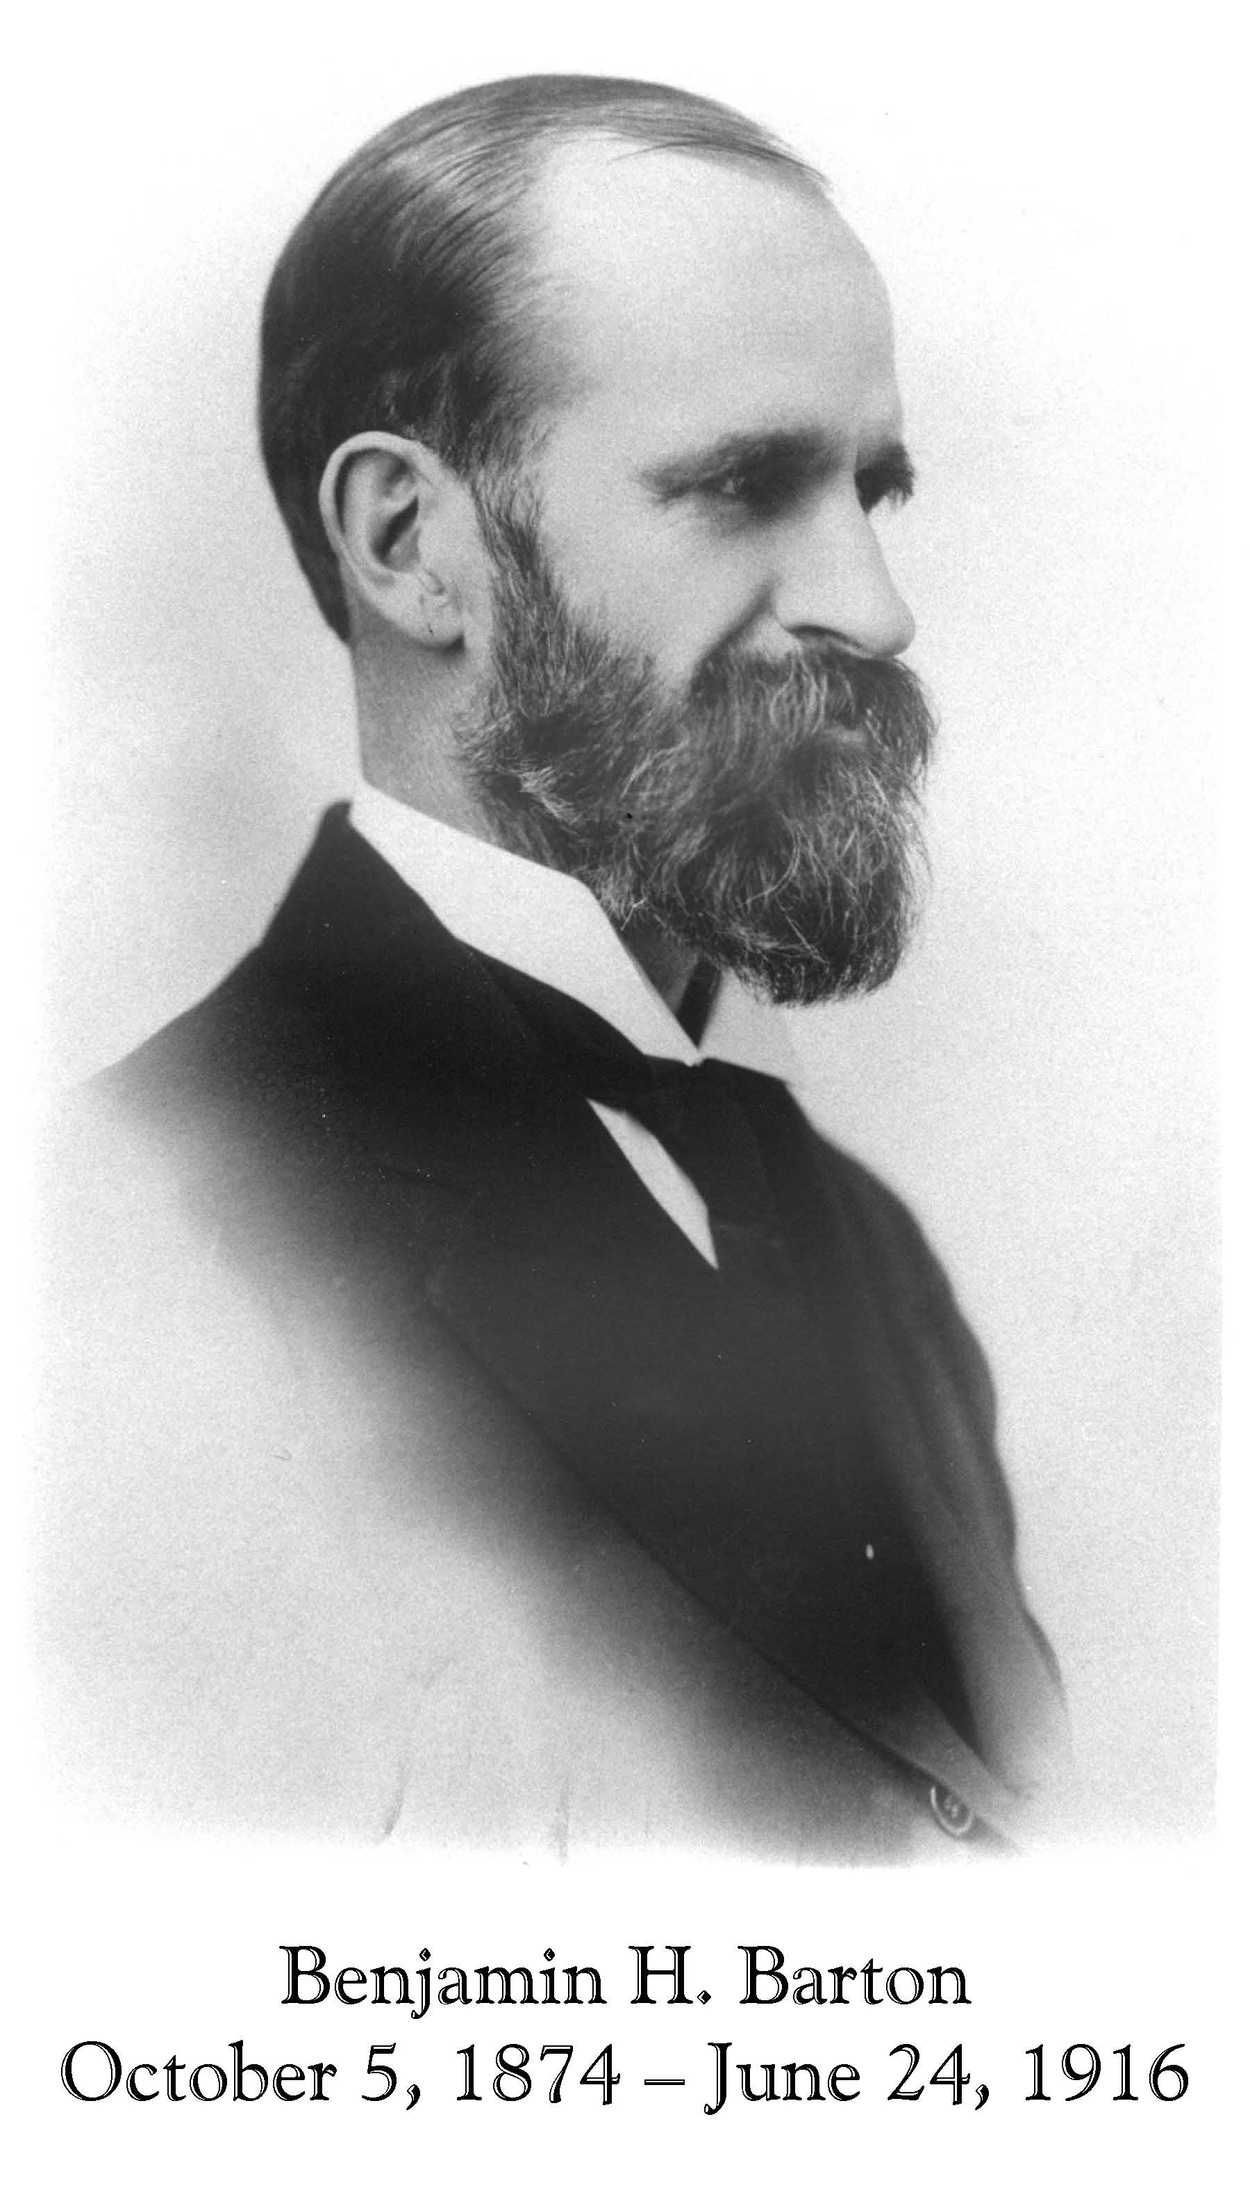
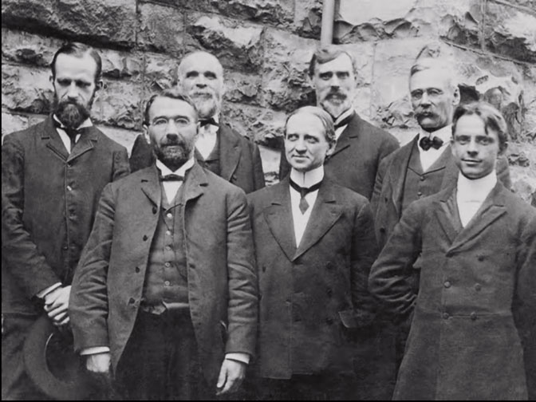
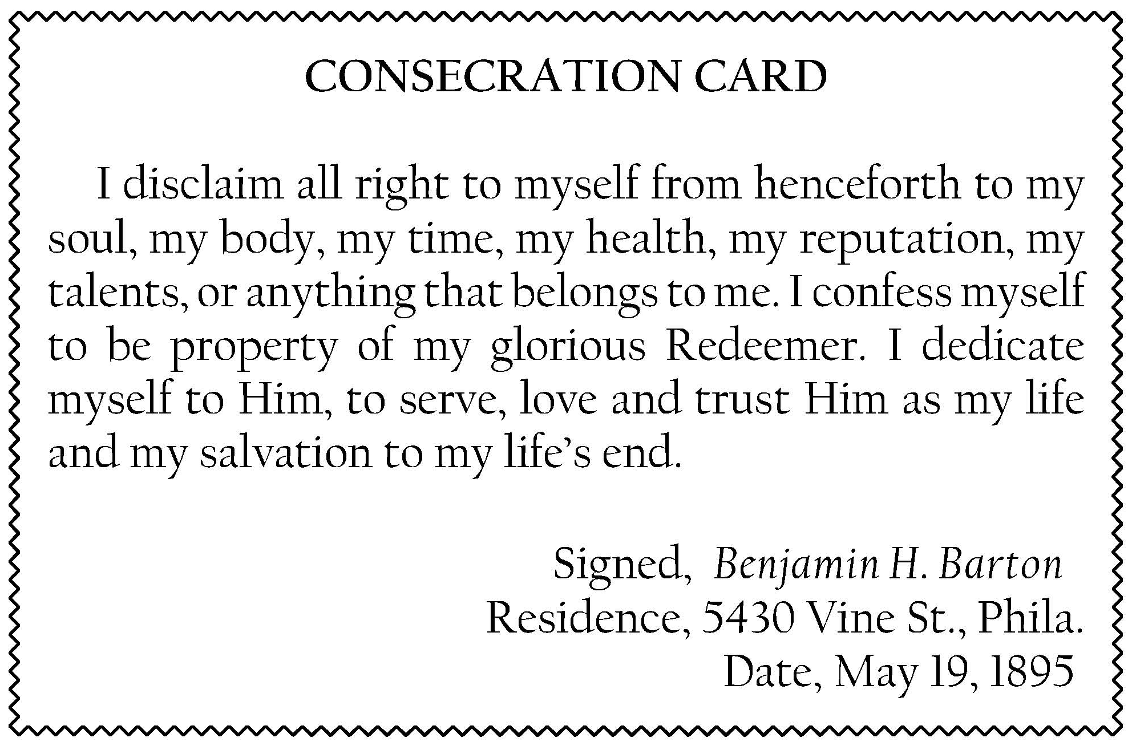

Slide 9
The Kingdom of God
Encouraging Lessons from Israel’s Tabernacle
Echoes from South Boston
Psalm 91
The Harp of God
84 Reasons We Believe We Have the Truth
All Things Work Together for Good
Aids to Spiritual Health – Great Physician
Bind the Sacrifice to the Horns of the Altar
The Rich Man and Lazarus
Echoes from Greenwood
The First and Second Adam
The Song of Solomon
Why Did God Give Us a Bible So Difficult
to Understand?
Living Stones of the Temple
Soldiers of Christ
Spiritual Sicknesses – Their Causes and Cure
The Highest Motive
God’s Covenants
Love Under the Test
Ransom and Sin-Offering
Comparative Results of Pride and Humility
Keeping the Heart
The Sin That Hath No Forgiveness
Lessons from the Life of Moses
The Benefits of Christian Fellowship
The Marks of Jesus
Ye Are a Holy Nation
The Seven Dippings in the River Jordan
Some of the Evidences of Consecration
Praise
Playing Kingdom
A Thousand Years Are but as Yesterday
Consecrated Thinking
Be Ye Enlarged
Discouragement
How We Can Successfully Perform
the Part of a Brother
Unblemished Priests
The Scripture Studies Seen in the Bible
An Analysis of 1 Corinthians Chapter 2
Sell That Thou Hast and Give to the Poor
Doing God’s Will
God’s Providences in Psalm 91

Slide 10
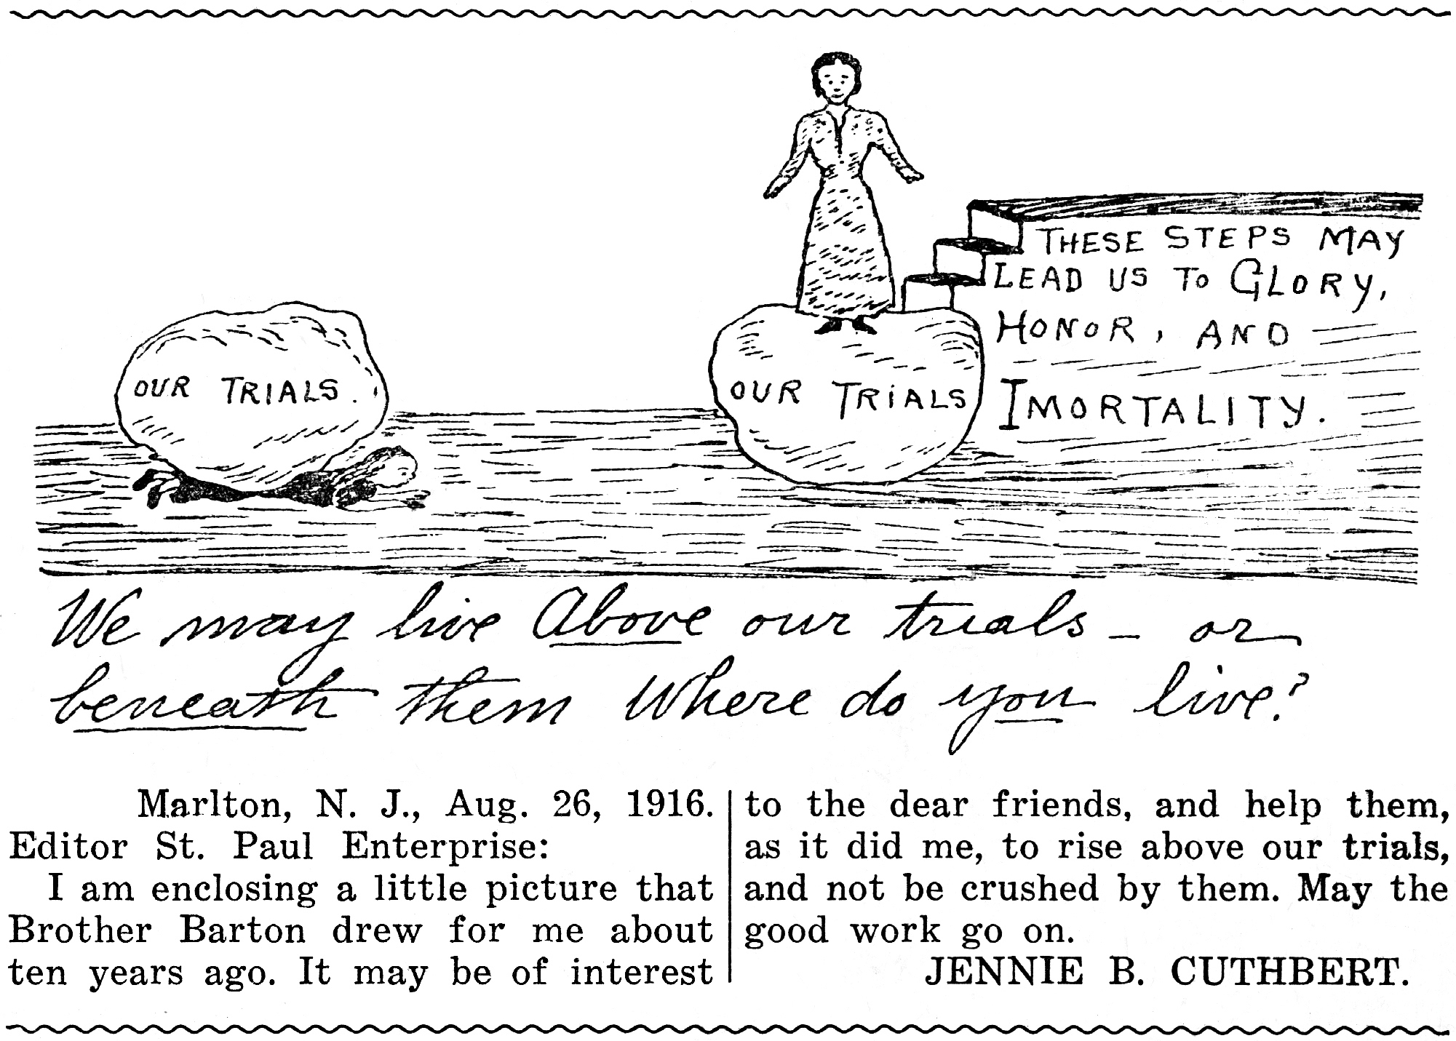
When you are content with any food, any raiment, any climate, any solitude, any interruption–that is VICTORY.
When you can bear with any discord, any annoyance, any irregularity, any unpunctuality (of which you are not the cause)–that is VICTORY.
When you are forgotten or neglected, or purposely set at naught, and you smile inwardly, glorying in the insult or the oversight–that is VICTORY.
When you can stand face to face with folly, extravagance, spiritual insensibility, contradiction of sinners, persecution, and endure it all as Jesus endured it–that is VICTORY.
When you never care to refer to yourself in conversation, nor to record your own good works, nor to seek after commendation, when you can truly “love to be unknown”–that is VICTORY.
When your good is evil spoken of, when your wishes are crossed, your taste offended, your advice disregarded, your opinion ridiculed, and you take it all in patient, loving silence–that is VICTORY.
Let Your Life Be a Bible
Let your life be a Bible,
Have Christ for its Genesis,
Have consecration for its Exodus,
Have love for its Leviticus,
Have joy for its Psalm,
Have the courage of a Daniel in it,
And the patience of a Job,
And the zeal of a Jeremiah,
And the love of a John,
And have plenty of Jesus in it.
And may the end of it be
As much grander than the beginning,
As Revelation is grander than Genesis.

Slide 11
St. Paul Enterprise: August 8, 1916
Barton Funeral Sermon
By Pastor C.T. Russell
Precious in the Lord’s sight is the death of our dear Brother Barton; and also precious in our sight. His course is run; he has delivered up what was committed unto him, and we believe that he is with the Lord.
In Isaiah 33:17, we read: “Thine eyes shall see the King in His beauty; they shall behold the land that is very far off.” Our dear Brother had a defect of vision, he was nearsighted. When he came into the Truth his vision was enlarged, he saw, by faith, a land that is very far off, and he saw something of the King and of His beauty. But what our Brother has seen by faith, we believe he now sees actually.
Our Brother was an architect. But when he got rightly in touch with the great Architect of the Universe, he dropped the pencil and the eraser and went forth to give his life in telling others of the wonderful plans and purposes of the great Architect. And so he spent his later years, showing forth the praises and telling of the Plan of the Architect of the Universe, that wonderful Plan founded on the sacrificial death of Jesus, telling how God was building a great spiritual Temple through which He would bless all the families of the earth.
I am sure that we have all heard our dear Brother, and have all remarked how clear the Plan was in his mind; and I feel like congratulating his parents that another has finished his course and has passed beyond the veil. For we have a most glorious hope, and do not mourn as do they of the “world,” who have not this hope.
I first became acquainted with our dear Brother Barton about seventeen years ago, when I first came to a knowledge of Present Truth; and to become acquainted with him was to love him, for I have never known him to manifest anything but the spirit of the Master.
Seventeen years ago Brother “Bennie” was one of the two Elders of the Philadelphia Ecclesia, and spoke on alternate Sundays with Brother Smith Walker, now also deceased. Brother Walker’s style was the pedagogic; Brother Barton’s the sympathetic. His heart seemed always overflowing with tenderness and love toward all, and many of his talks to the Friends were in the nature of a spiritual medicine specially adapted to the needs of the class at that particular time, and most wisely and lovingly administered.

Slide 12
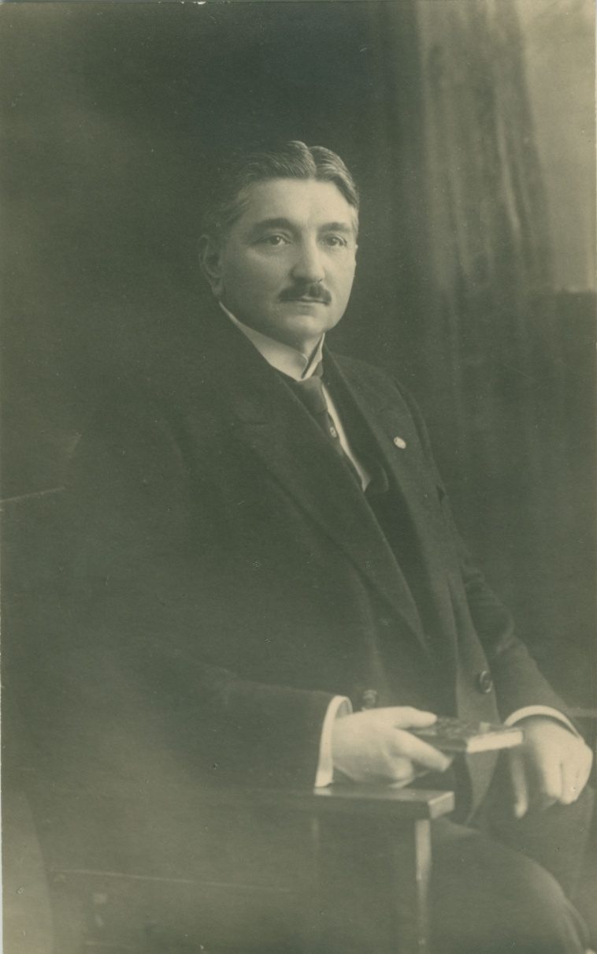
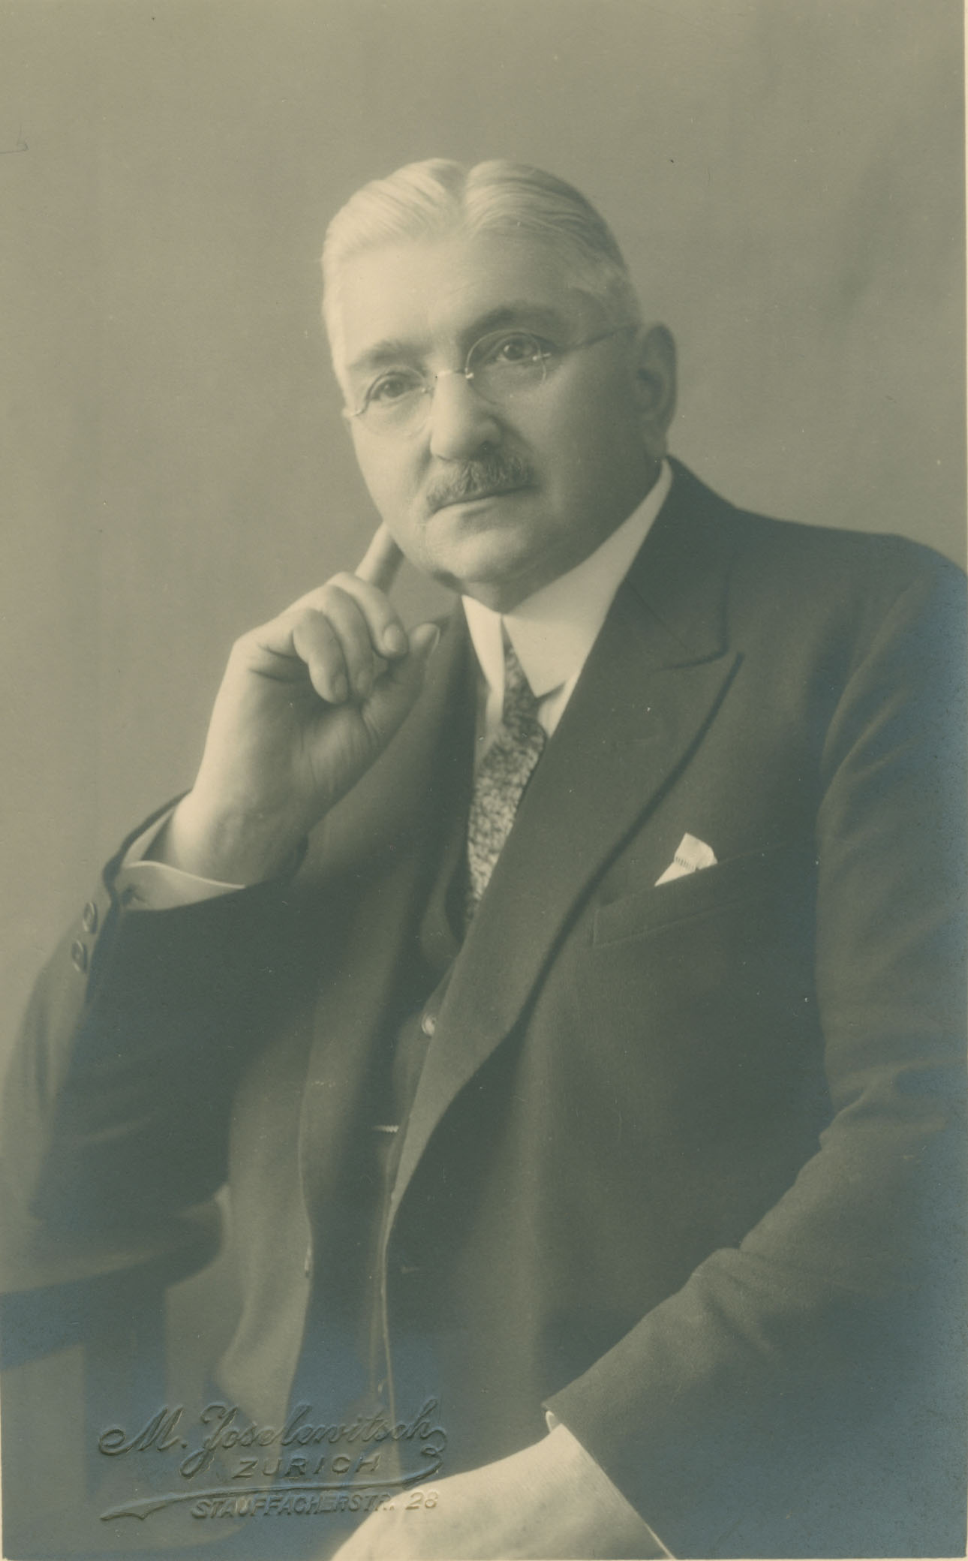
Conrad Binkele
1867 ~ 1942

Slide 13
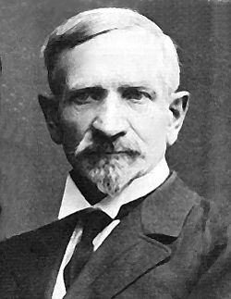
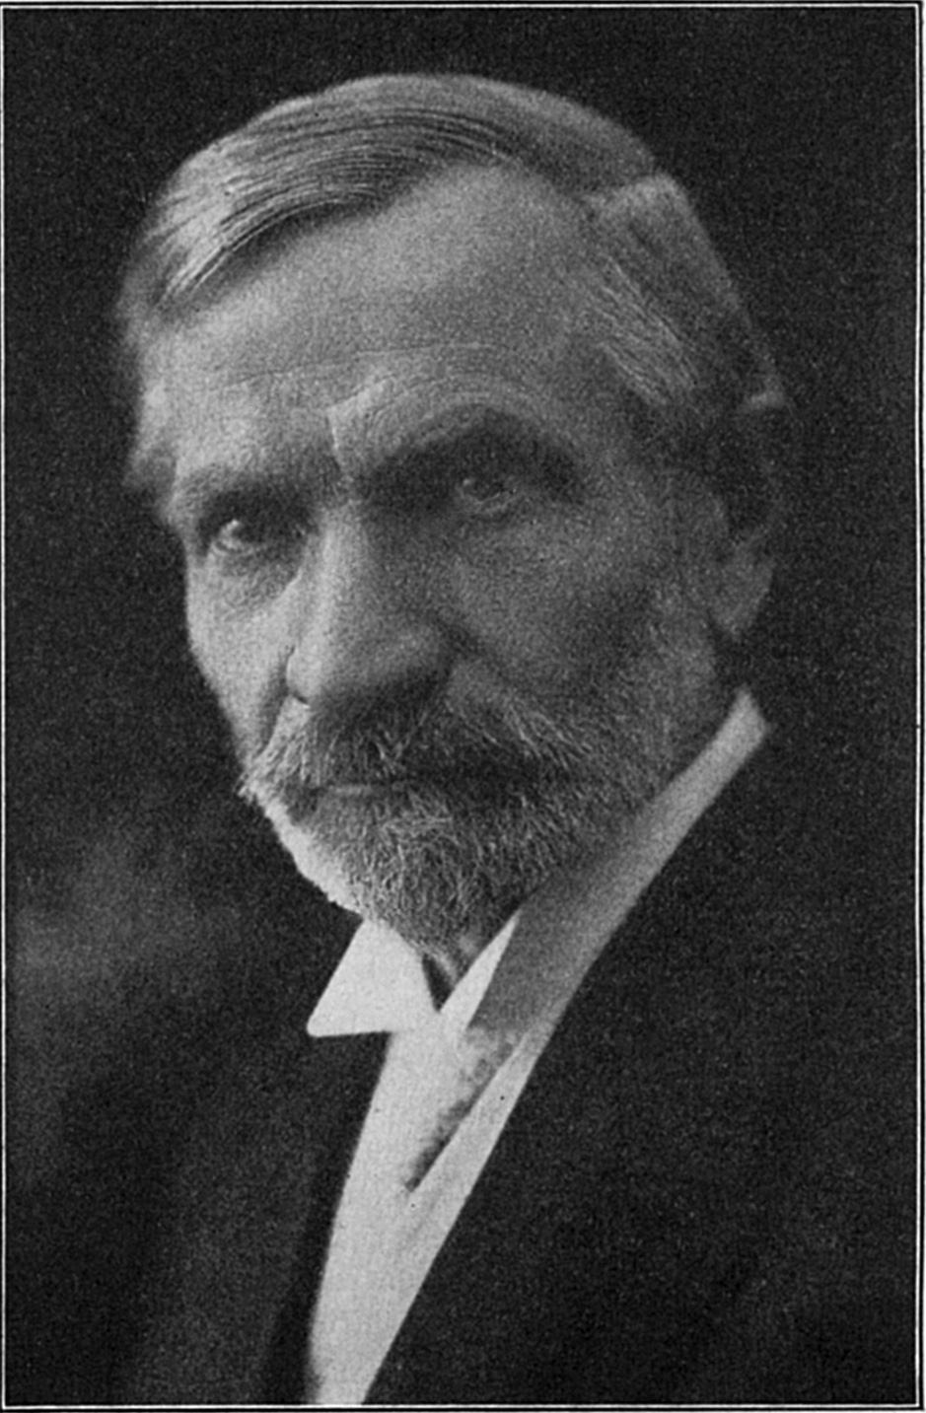
Hipolit Oleszynski
1857 ~ 1930

Slide 14
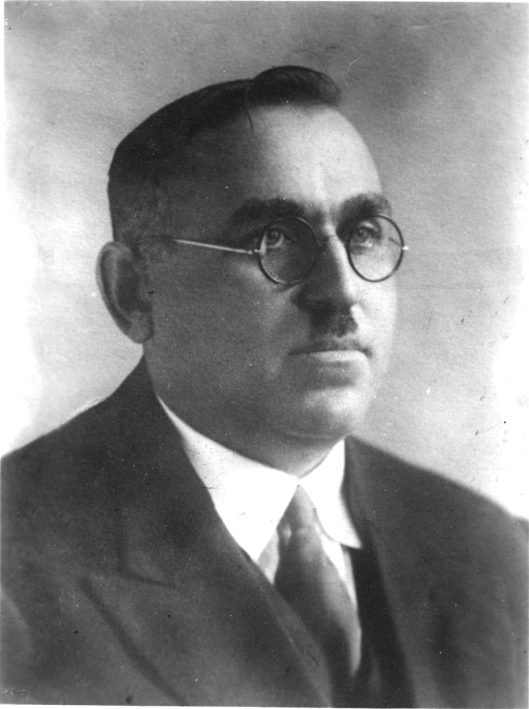
August Stahn
1888 ~ 1945

Slide 15
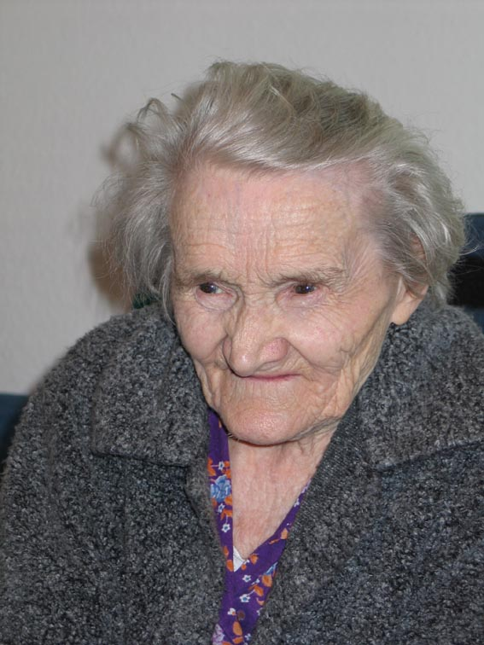
Jannina Fitz
1918 ~ 2008

Slide 16
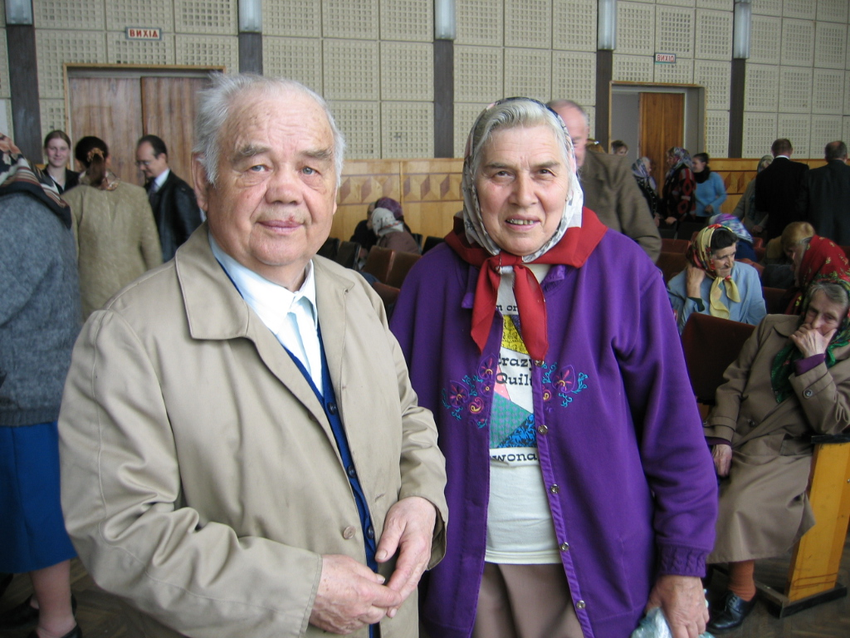
Iwan & Maria Krawetz

Slide 17


Slide 18
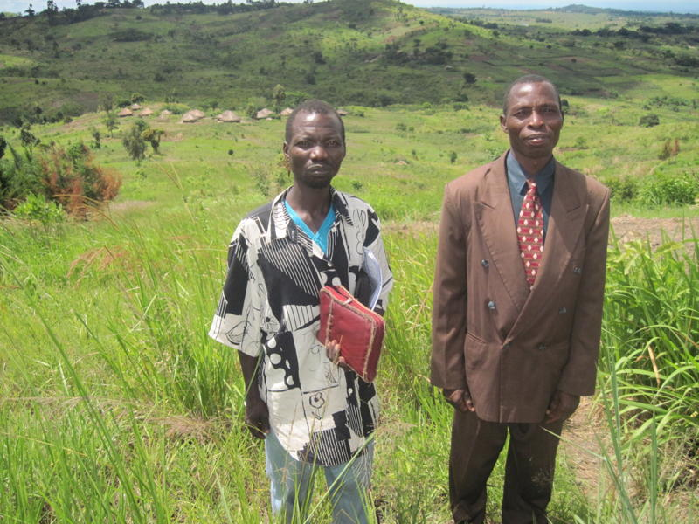


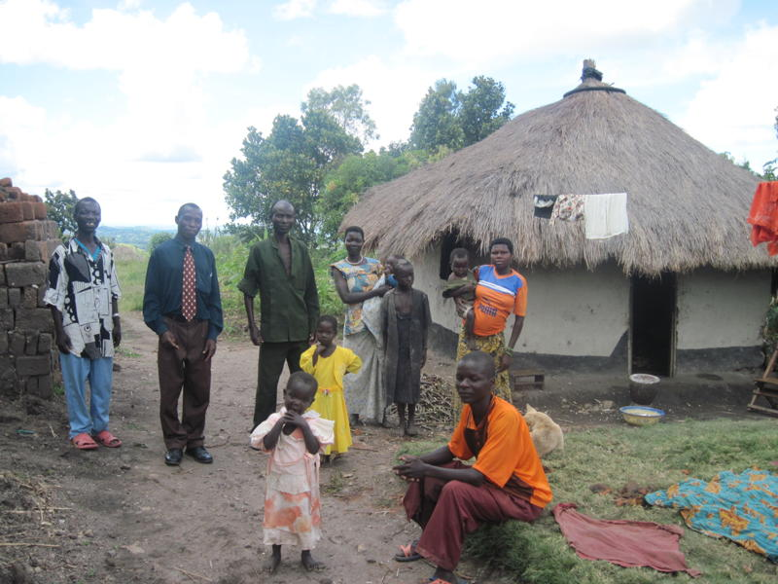

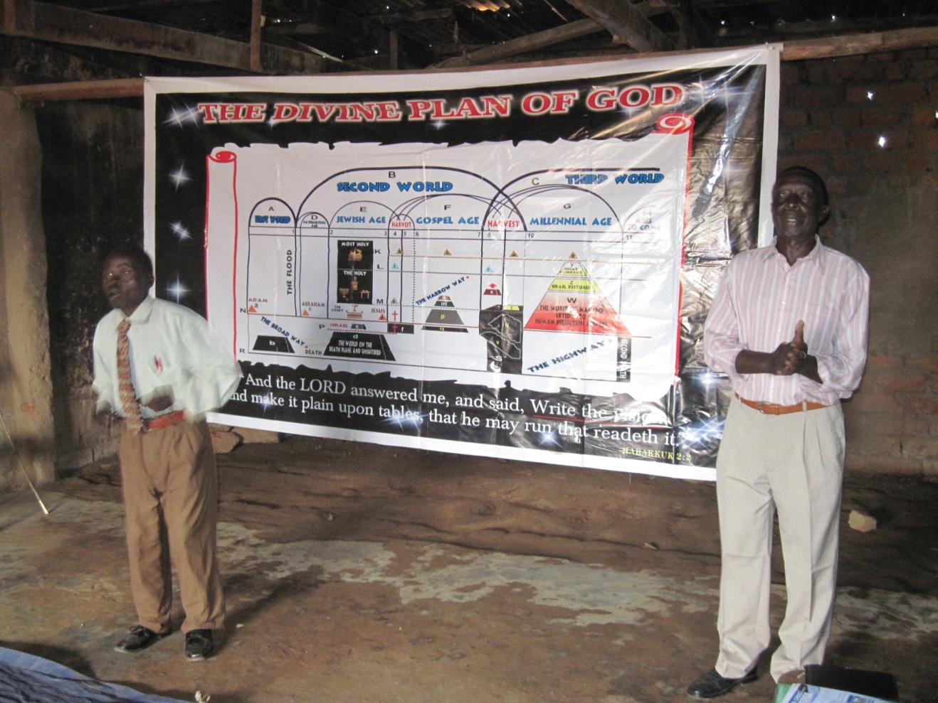
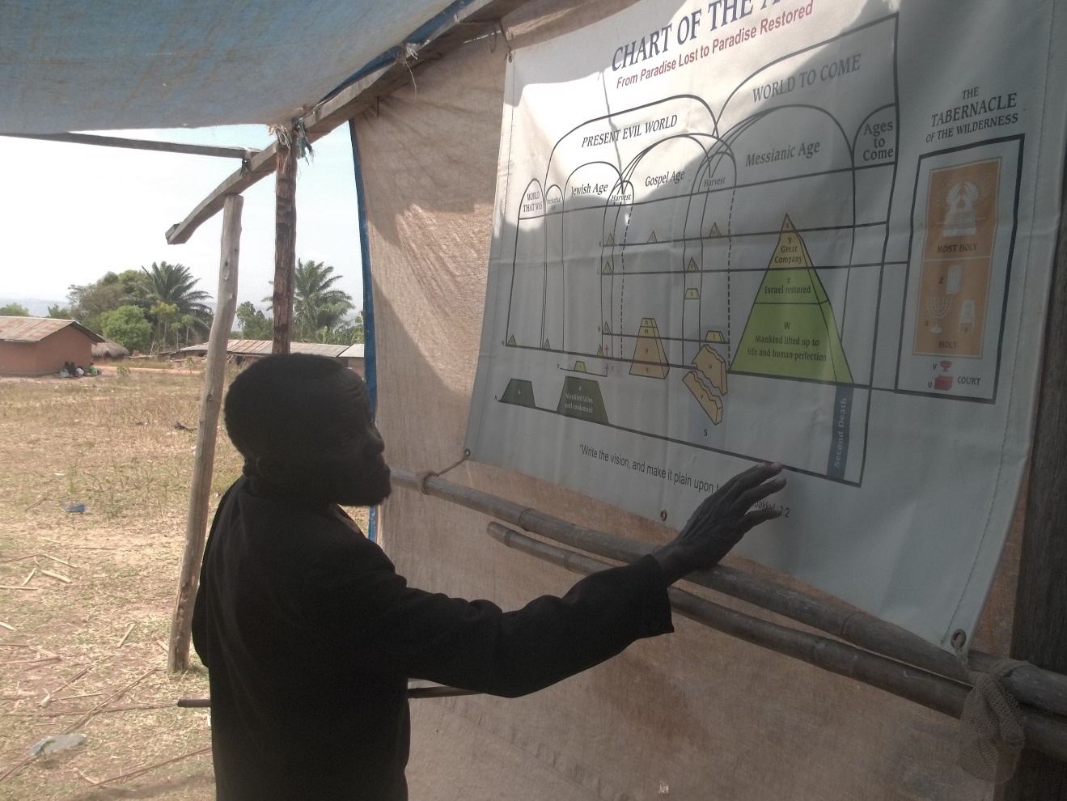
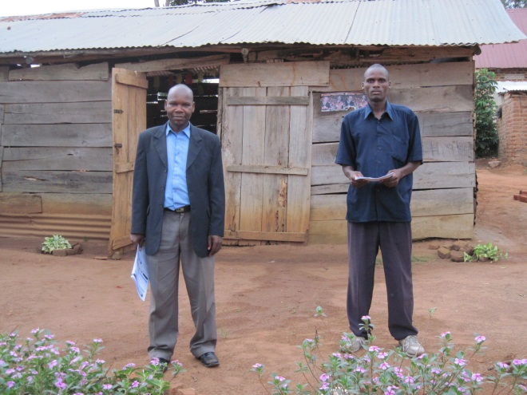

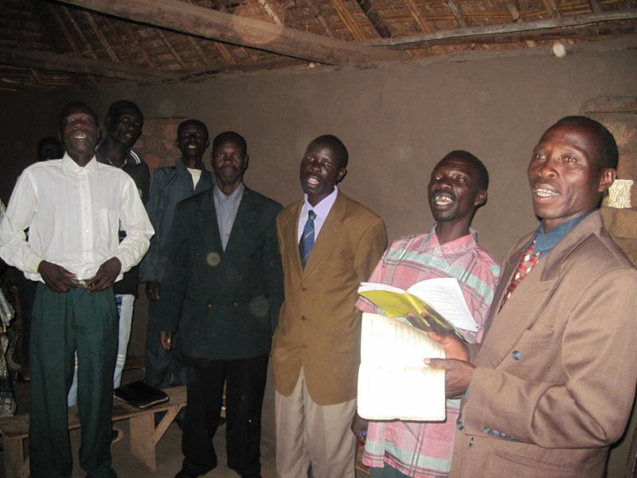
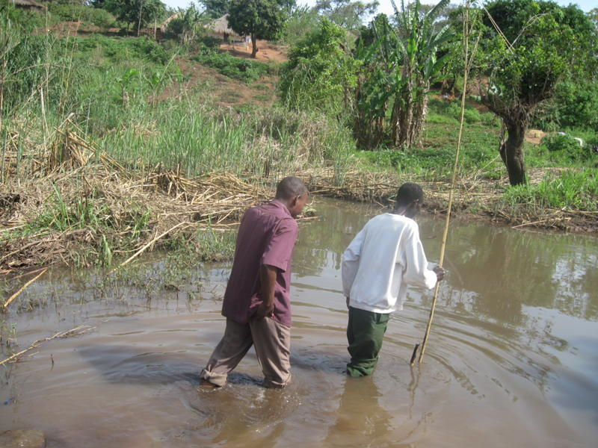
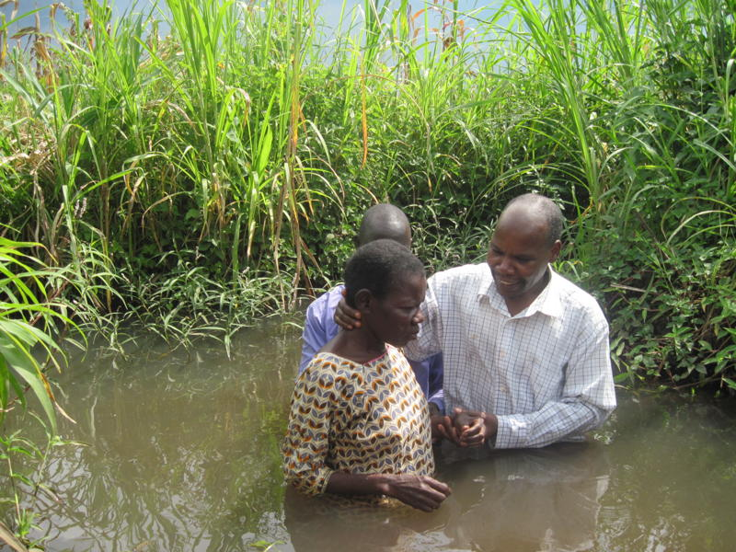

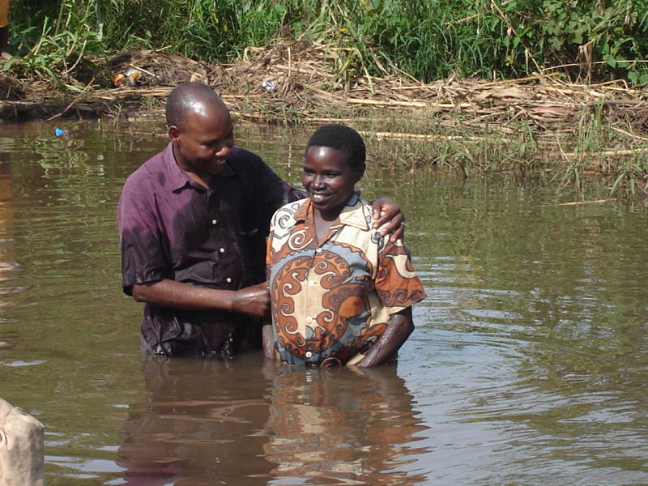


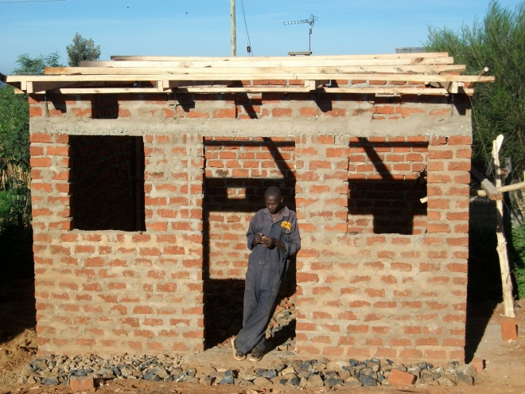

Slide 19

R:3897– from a letter written to the Pastor describing one brother’s experiences at a convention he had attended.
“We thought of the progress these dear friends had made, as we looked into their beaming faces and saw the beautiful lines traced there by the divine artist; lines and coloring that told of the beauty of thoughts, desires and hopes stored away in each bosom, and we seemed to hear the heart-throbs utter, “none of self, and all of thee.”
And then we noticed lines and features that indicated discipline, hardness as good soldiers, firmness, decision, patience, etc. And we were impressed, and at once tightened our armor a little more and grasped the weapons of our warfare a little more firmly, and faced about a little squarer and stood a little straighter, and our hearts responded, “Yea, Lord, we are ready to follow even unto death.”

Slide 20
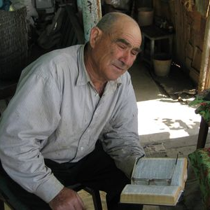
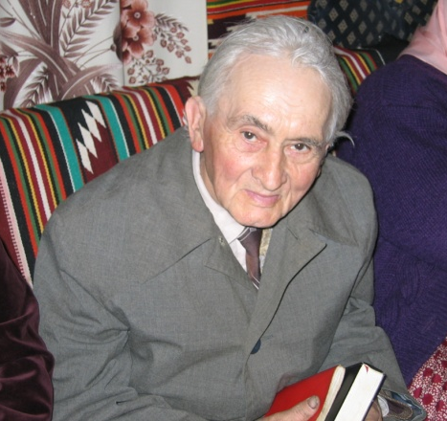
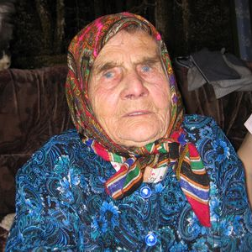
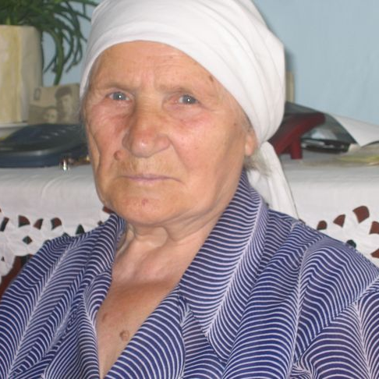
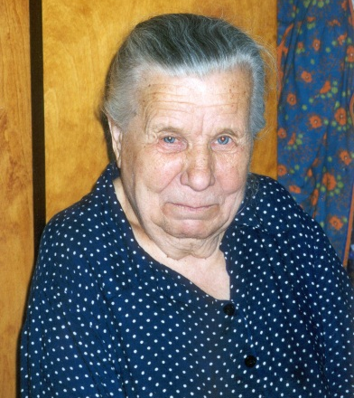
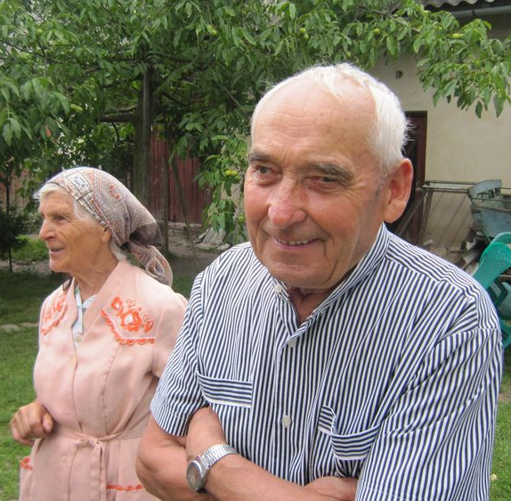
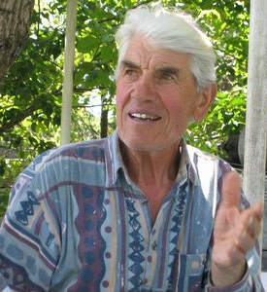
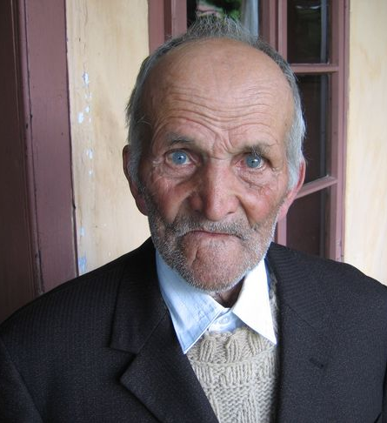
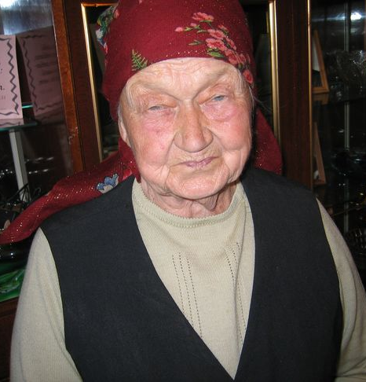






Slide 21





Slide 22



Slide 23
www.BibleStudentArchives.com
~ Lives & Chronicles
1Peter 5:10
May the God of all grace, who hath called us unto his eternal glory by Christ Jesus, after that ye have suffered a while, make you perfect, stablish, strengthen, settle you.

