Slide 1
Never Sympathized Man Like This Man
North Seattle Convention – March 29, 2015

Slide 2
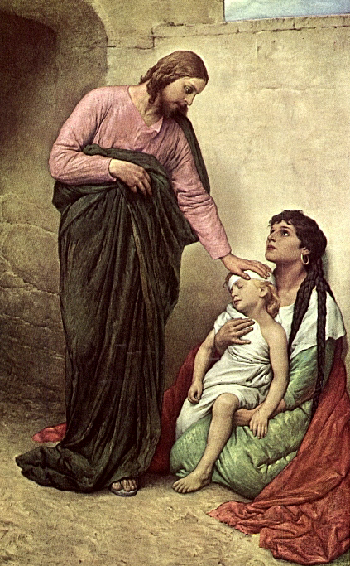
How can a perfect man be the most sympathetic one of all?
to a race of fallen human beings?

Slide 3
Proverbs 8:30 - then I was beside him, like a master worker; and I was daily his delight, rejoicing before him always,
Proverbs 8:31 - rejoicing in his inhabited world and delighting in the human race.

Slide 4


Isaiah 53:2 For he shall grow up before him as a tender plant, as a root out of dry ground.

Slide 5
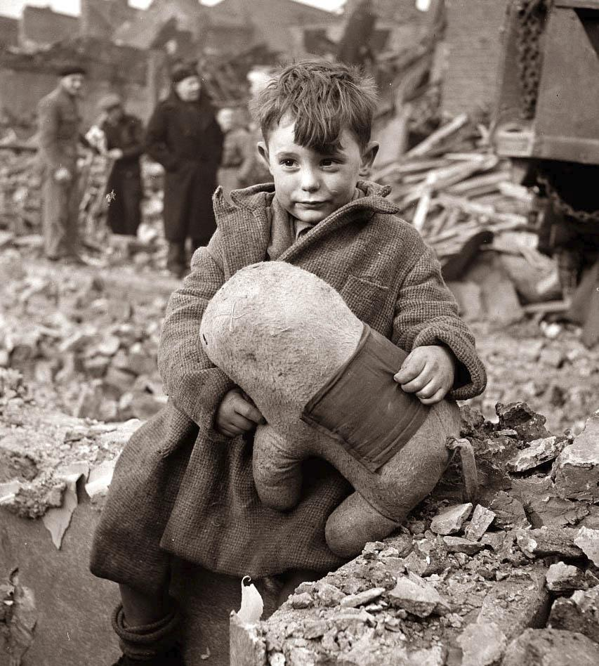
Jesus “sympathy was touched, because his nature was fine, perfect, touchable – not hard, not calloused with sin and selfishness.” E126

Slide 6
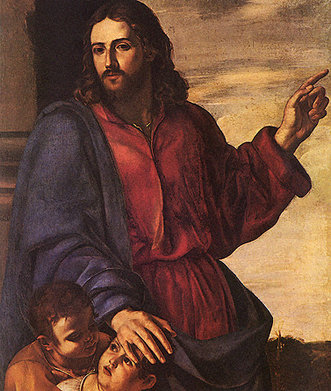
He who spake “as never man spake” also sympathized, as none of the fallen race could sympathize. E126

Slide 7
Never Sympathized Man Like This Man
Heb 4:15 For we have not an high priest which cannot be touched with the feeling of our infirmities; but was in all points tempted like as we are, yet without sin.
“touched with the feeling” – Strong’s 4834 – sumpatheo - to feel “sympathy” with, that is, (by implication) to commiserate: - have compassion, be touched with a feeling of
Mat 9:36 But when he saw the multitudes, he was moved with compassion on them, because they fainted, and were scattered abroad, as sheep having no shepherd.
“moved with compassion” – Strong’s 4697 – splagchnizomai - to have the bowels yearn, that is, (figuratively) feel sympathy, to pity: - have (be moved with) compassion

Slide 8
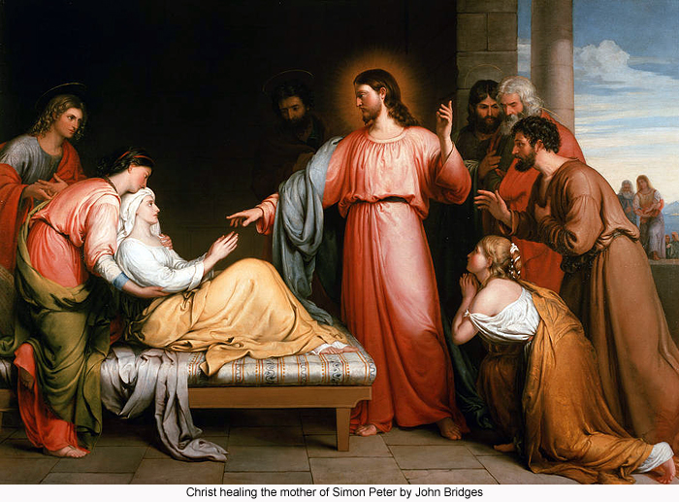
Matthew 8:17 Himself took our infirmities and bare our sicknesses.

Slide 9
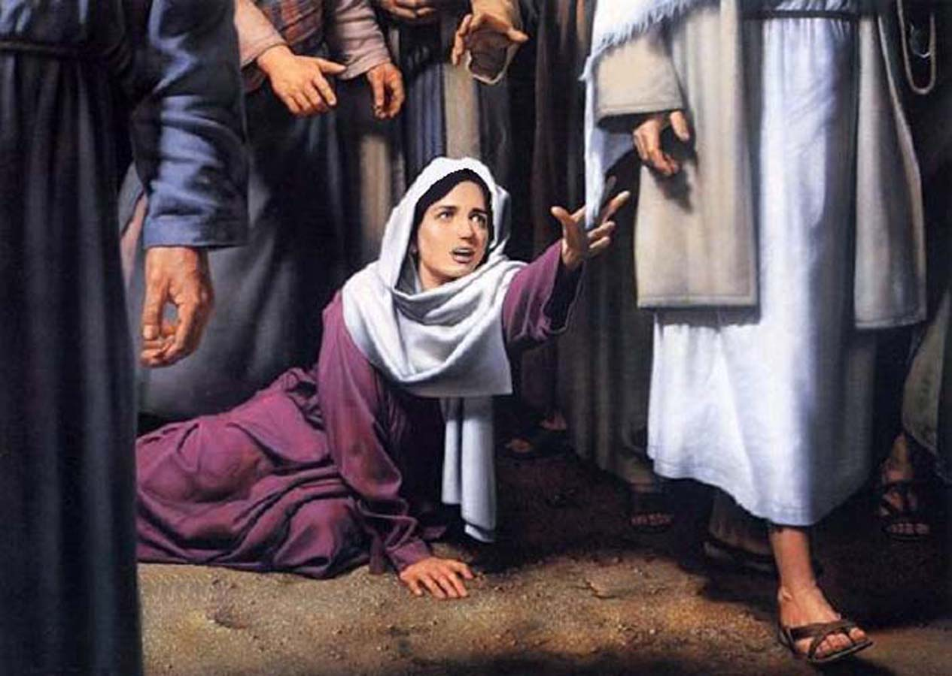
Mark 5:28 For she said, If I may but touch only His clothes, I will be cured.

Slide 10
Mark 5:34 He said to her, Daughter, your faith has made you well. Go in peace, and be whole from your plague.

Slide 11
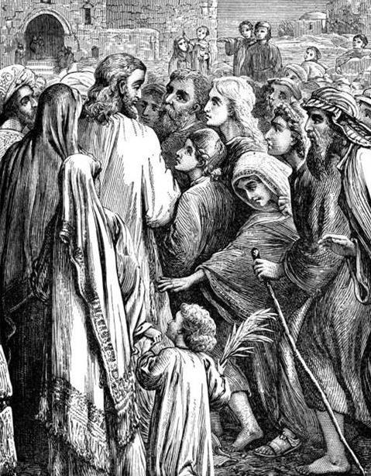
Luke 6:19 And the whole multitude sought to touch him: for there went virtue out of him, and healed them all.

Slide 12
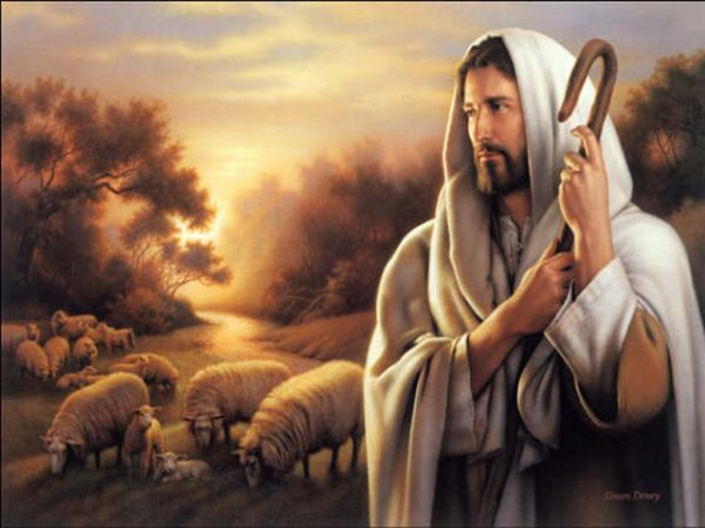
How did Jesus react to the multitudes and the drain on his vitality?

Slide 13
He gave his disciples power over unclean spirits to cast them out and to heal every kind of disease and sickness.
Matthew 10:1

Slide 14
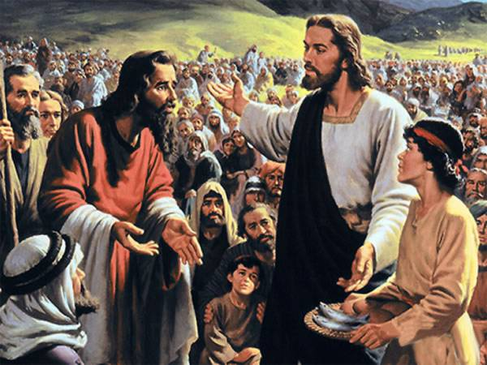
Does the Shepherd leave his sheep when he is tired?

Slide 15
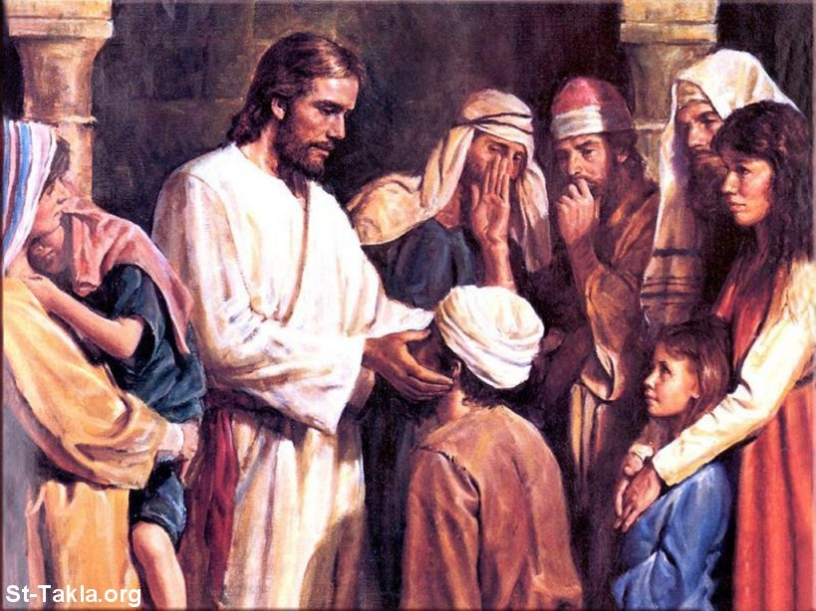
He has done all things well. He makes both the deaf to hear and the dumb to speak. Mark 7:37

Slide 16
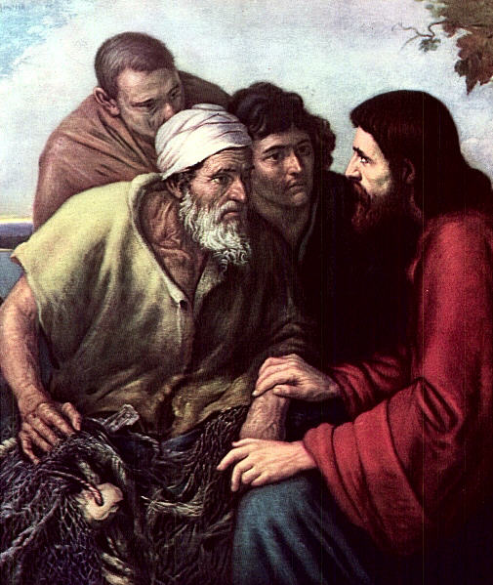
And the common people heard him gladly.
Mark 12:37

Slide 17
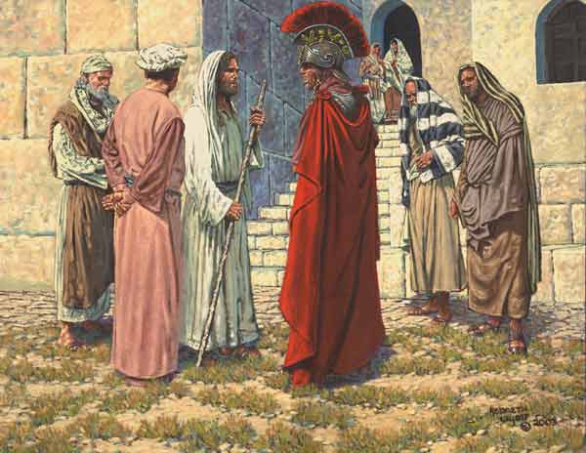
I have not found such great faith with anyone in Israel. Matthew 8:10

Slide 18
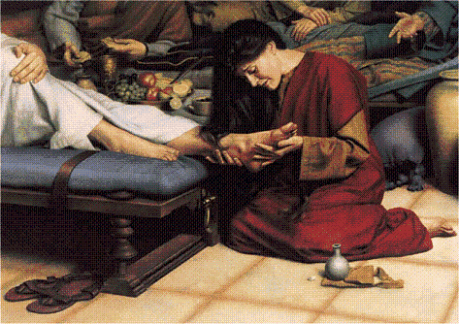
Thy sins are forgiven . . . Thy faith hath saved thee, go in peace. Luke 7:48, 50

Slide 19
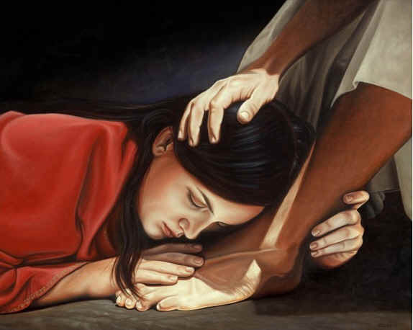
Her sins, which are many, have been forgiven, for she loved much. Matthew 7:47

Slide 20
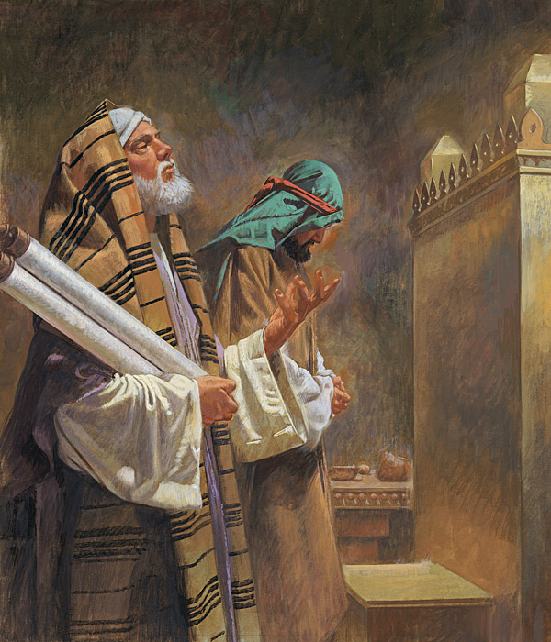

Slide 21
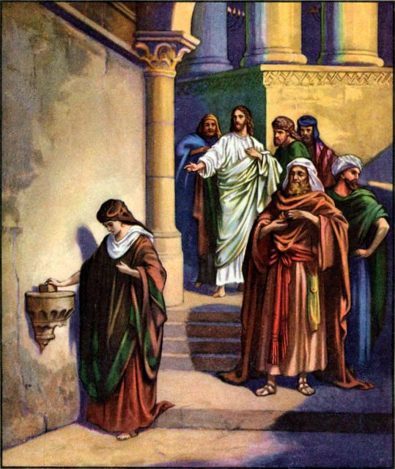
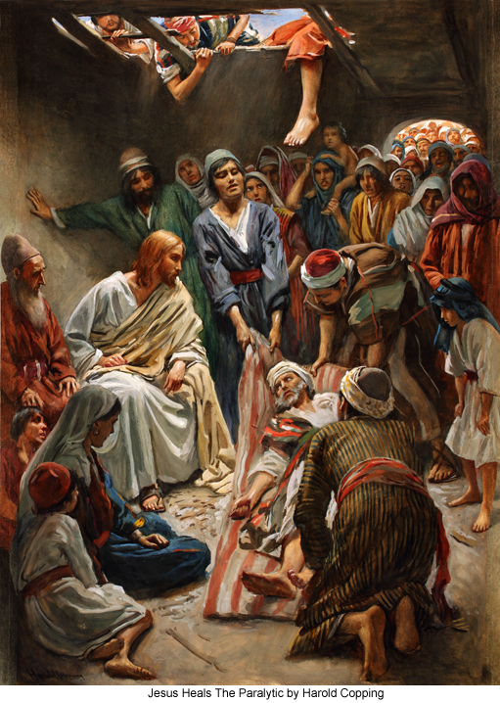

Slide 22
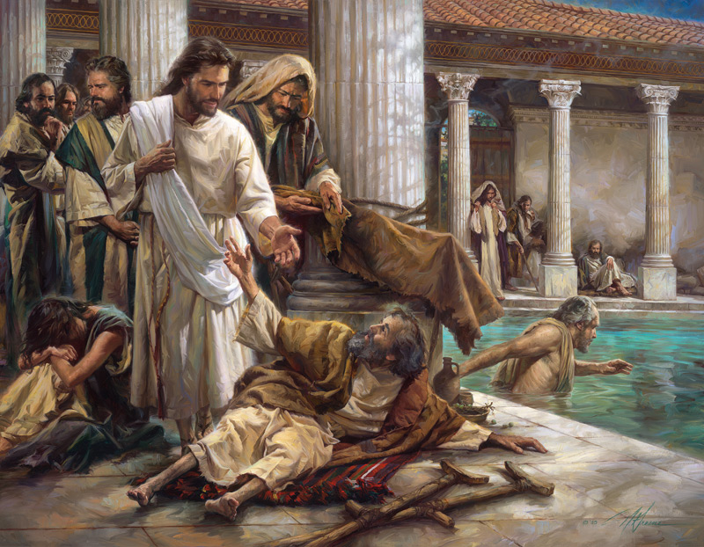

Slide 23
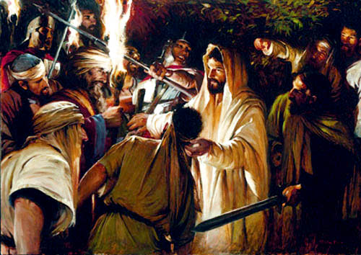

Slide 24
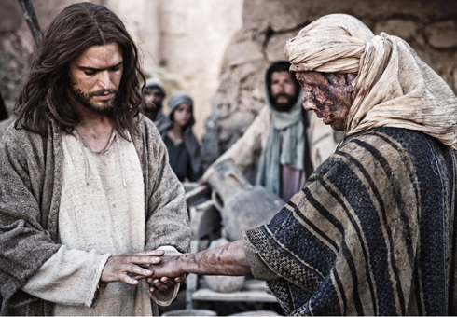

Slide 25
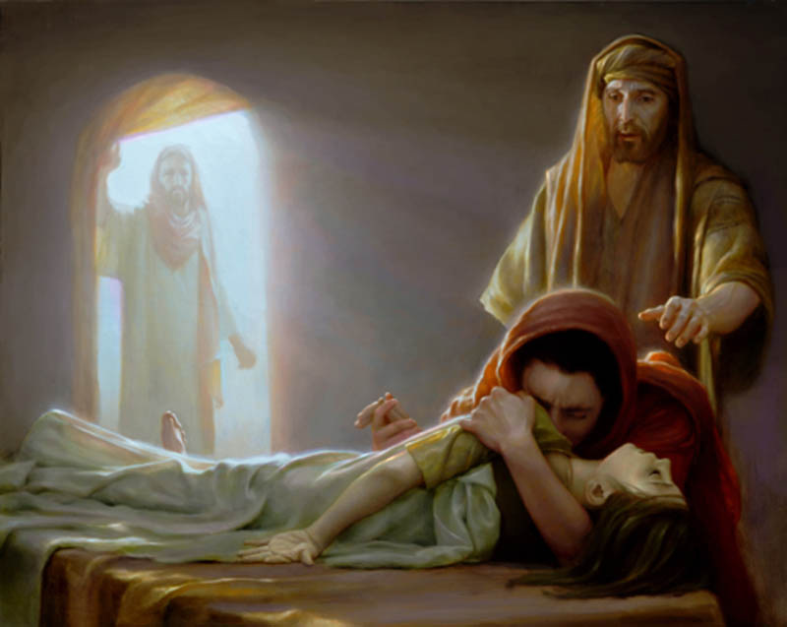

Slide 26
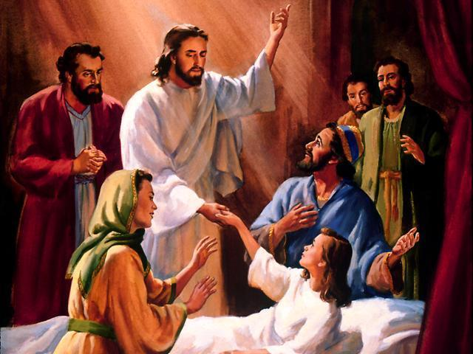

Slide 27
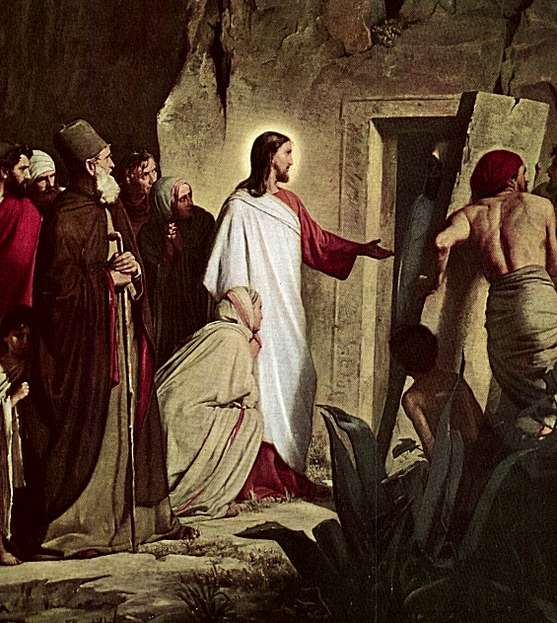

Slide 28
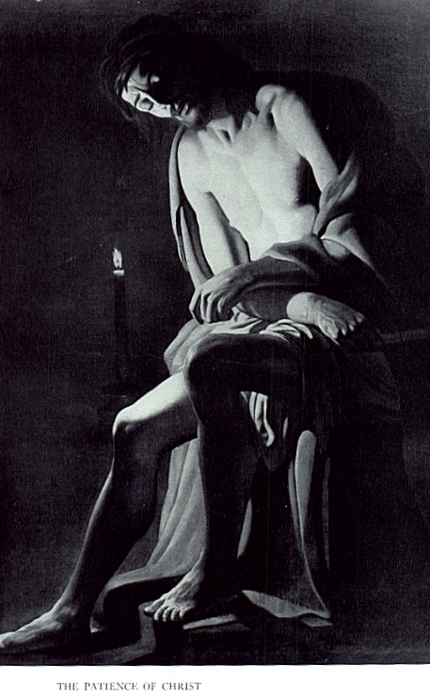
John 10:11, 18 I am the Good Shepherd. The Good Shepherd lays down His life for the sheep . . . No one takes my life from me, but I lay it down of my own accord. I have power to lay it down, and I have power to take it up again.
Isaiah 53:10 , 12 His life was an offering for sin . . He has poured out His soul unto death.
2 Corinthians 5:21 - He made Him who knew no sin to be a sin offering on our behalf, that we might become the righteousness of God in Him.

Slide 29
Never Sympathized Man Like This Man
E126-127 The object for which our Lord came into the world was not to simply manifest power without cost to himself, but, as he himself explained it, the Son of Man came to minister to others, and to give his life a ransom for many. True, the wages of sin was not suffering, but death; and hence suffering on our Lord's part would not alone pay the wages of sin for us; it was absolutely necessary that he should "taste death for every man." Hence we read, "Christ died for our sins, according to the Scriptures." (1 Cor. 15:3)

Slide 30
Never Sympathized Man Like This Man
E126-127 Nevertheless, it was appropriate that in taking the sinner's place our Lord should experience all that was implied in the curse--the penalty of death: and inasmuch as the human family has died, by a process of gradual loss of life, through weakness, sickness and infirmity, it was correspondingly appropriate that our dear Redeemer should pass through this experience also. And since he himself was not the sinner, all the penalties of sin which could rest upon him must be as the result of his taking the sinner's place, and bearing for us the stroke of Justice.

Slide 31
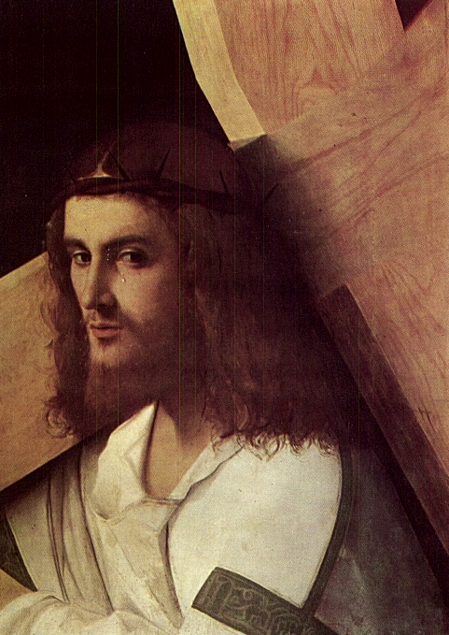
Never sympathized man like this man.
Heb 4:15 For we do not have a high priest who is unable to sympathize with our weaknesses, but we have one who in every respect has been tested as we are, yet without sin.

Slide 32
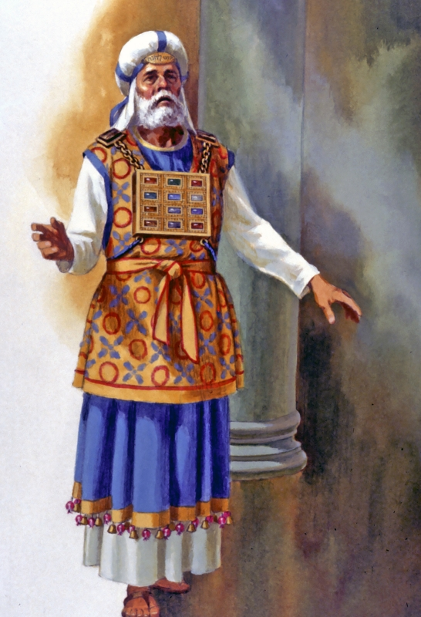
Never Sympathized Man Like This Man
Heb 5:1 For every high priest taken from among men is ordained for men in things pertaining to God, that he may offer both gifts and sacrifices for sins:
Heb 5:2 Who can have compassion on the ignorant, and on them that are out of the way; for that he himself also is compassed with infirmity.

