Slide 1
WHAT IS FAITH?
Notes:
The subject we chose to discuss with you this evening is extremely important for the New Creation to understand. Why? Because Without Faith, it is not “improbable”, but IMPOSSIBLE, to please God. And our goal, as consecrated children of God, is to live a life pleasing to him. The New Creation walks by what…faith, not by sight. 2 Cor. 5:7. And the just shall live by what…faith. Romans 1:17 And by grace are we saved through what…faith. Ephesians 2:8 And finally, to receive the crown of life, we must be what unto death…faith - full? Revelation 2:10
The Apostle Paul states, in Hebrews 10:23, "Let us hold fast the profession of our faith without wavering; for He is faithful that promised.” Here he is writing to some in the early Church who had given evidence of wavering, who were failing properly to hold on. He is telling them that while they had been faithful at one time they apparently had become lukewarm, at least, respecting the Lord and the Christian way. He intimates that the firmness of faith in the child of God, and the firmness with which he holds the profession of his faith, has much to do with his consistency in the Christian life R5698. So we see that faith is an integral part of the life of the New Creation.
But what is faith?
NEXT

Slide 2
WHAT IS FAITH?
WHAT ARE WE TO HAVE FAITH IN?
IS FAITH BASED UPON REASON?
How is faith increased?
Notes:
In order to understand this subject better, we are going to examine four questions during the next hour.
So to begin, we would like to ask, “what is the scriptural definition of faith?”
NEXT

Slide 3
Now faith is the substance of things hoped for, the evidence of things not seen. Hebrews 11:1
Now faith is the BASIS or FOUNDATION of things EXPECTED, the AVAILABLE BODY OF FACTS of things not seen.
Hebrews 11:1
Notes:
What does the first portion of Hebrews 11:1 mean, “Faith is the substance of things hoped for.” Let us take a look at the word “substance” and the word “hope”. What do these two words mean? The word “sub…stance” effectively means basis or foundation. The word “hope” means to anticipate or expect. So to say it in another way, we may reword the first part of Hebrews 11:1 thus, “Now faith is the BASIS or FOUNDATION OF things that we ANTICIPATE or EXPECT”.
Hope has to have a foundation like a bouquet of flowers need a vase.
Could we hope for anything without a basis or foundation for that hope? None of us has ever seen a perfect man, earth or society, but yet we hope for this (we expect this in the future). How could we hope for these things? Those of us who have made a full, unreserved consecration, hope (or anticipate) to be part of the Bride of Christ on a spiritual plane of existence which we can scarcely comprehend; part of a class which the lord will use to teach the world righteousness and to bring them up to perfection. As a matter of fact, our hope in this prospect is so strong that we have staked our entire lives on it. The world would say that that is a pretty big gamble, wouldn’t they? But for us it’s not a gamble…it’s the greatest bargain ever offered. But why would we hope for this? Well, the answer is that we could not hope for such things without substance or a basis or a foundation for that hope. So what is the substance? What is the basis? What is the foundation? It is God’s word isn’t it…he promises these things in his word. This is the “Sure Foundation” upon which we can build these hopes.
The second portion of Hebrews 11:1 states that “faith is the evidence of things not seen.” We have an example that may help illustrate this, but first let us take a look at the word evidence. DEFINITION: the available body of facts or information indicating whether a belief or proposition is true or valid. ORIGIN Middle English : via Old French from Latin evidentia, from evident- ‘obvious to the eye or mind’.
Let’s replace these two words (substance and evidence) with their respective definitions and plug them into Hebrews 11:1 and see what we come up with.
NEXT
Now let us look at a little example of how faith works.
NEXT

Slide 4
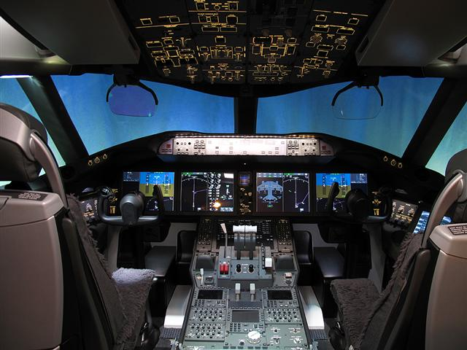
WHAT ARE WE TO HAVE FAITH IN?
Notes:
Can anybody tell me what we are looking at? The cockpit of an airplane? How many of you flew to this convention?
Brethren, when a pilot flies a plane high into thick clouds or into a storm at night, what do you think he sees when looking out the cockpit window? The answer is, “Absolutely Nothing”. Nothing but pitch black…he cannot see the ground; the stars; the horizon; nor anything in front of the plane. The front windshield is no more useful than if it were a solid wall. So how does the pilot safely fly the plane? The answer is by exercising full faith in the flight instruments. There is no possible way for a pilot to determine his altitude; air speed; attitude or heading without these instruments…he must rely fully on what they are telling him in order to maintain a proper and safe flight. The flight instruments on an airplane are evidence of things that are not seen by the natural eye.
This example leads us to an examination of our first question, “What are we to have faith in?”
NEXT
Imagine these flight instruments as being the Precious Promises of God. As the pilot flies into storms and thick clouds, he must rely completely on what his instruments are telling him. So likewise, the New Creation must rely wholly on the promises of God, we must trust him even when we cannot trace him, and we are to “Trust in the LORD with all our heart; and lean not unto our own understanding” Proverbs 3:5. Do you know what happens to pilots when they lean to their own understanding and do not trust what their instruments are telling them?
The NTSB (National Transportation & Safety Board) has ruled “Pilot Error” as the result of several plane crashes. Do you know what kind of error caused some of these crashes? The error was that the pilot did not believe what his instruments were telling him. Now to be fair, often times during these incidents, one of the instruments would fail and lead the pilot to believe that the other instruments had failed as well. But you and I have a more sure word of prophecy don’t we? The promises which the Lord has given to us will never fail. I Kings 8:56: Blessed be the LORD, that hath given rest unto his people Israel, according to all that he promised: there hath not failed one word of all his good promise, which he promised by the hand of Moses his servant. Isaiah 55:11 So shall my word be that goeth forth out of my mouth: it shall not return unto me void, but it shall accomplish that which I please, and it shall prosper in the thing whereto I sent it. As the flight instruments on an airplane guide the pilot safely to his destination, so the precious promises guide the new creation to his ultimate destination…the divine nature. II Peter 1:4 Whereby are given unto us exceeding great and precious promises: that by these ye might be partakers of the divine nature…
NEXT

Slide 5
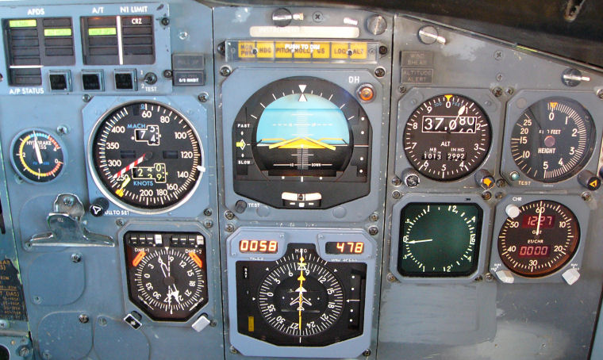
Notes:
Looking at an instrument panel inside the cockpit with an untrained eye can be a little daunting, but in reality, among the plethora of instruments, dials, switches and buttons, there are really only four primary flight instruments which are used for guiding the aircraft and keeping it aloft…the airspeed indicator; the artificial horizon (otherwise known as the attitude indicator); the altimeter and the heading indicator. Does anybody know what will happen to an airplane when it flies too slow? It will stall. Does anybody know what will happen if an airplane files too fast? If an airplane flies too fast, a disruption in airflow above the wing creates shock fronts which increase drag and reduce lift.
NEXT

Slide 6
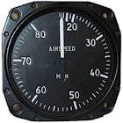
Notes:
So the airspeed indicator is of paramount importance, as the pilot must maintain a flight speed that is not too slow, but also not too fast. Likewise, we too are admonished by the apostle Paul in Hebrews 12:1 to, “…run with patience the race that is set before us; and in 1 Corinthians 9:26 to, “…fight, not as one that beateth the air.” Having thus "girded up the loins of your mind" for a long, steady and determined effort, he further counsels,--"Be sober:" do not allow yourself to become excited and, under the spur of excitement, to exhaust all your spiritual vitality in a very short time, and then to suffer a relapse into coldness or discouragement; but thoughtfully to consider and prepare for a long and patient endurance of all the discipline and trial of faith and patience necessary to prove an overcomer and worthy of the blessed reward promised "to him that overcometh.” The race before us is not one to be run by fits and starts, but by "patient continuance in well doing.”
Talk about my school story…I learned this first-hand.
NEXT

Slide 7
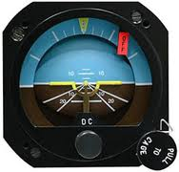
Notes:
The artificial horizon, also known as an attitude indicator, is an instrument used in an aircraft to inform the pilot of the orientation of the aircraft relative to earth. It indicates pitch (fore and aft tilt) and bank or roll (side to side tilt) and is a primary instrument for flight in instrument meteorological conditions. The attitude of the aircraft has everything to do with maintaining flight. Without this instrument, the pilot has no way to correct the attitude of the aircraft, especially when visibility impairs his reference to the horizon.
We too must constantly correct our attitude and bring it into harmony with the divine character. What faith instruments can we use to correct our attitude? How about 2 Corinthians 9:7 God loveth a cheerful giver. Or perhaps Philippians 4:8: Finally, brethren, whatsoever things are true, whatsoever things are honest, whatsoever things are just, whatsoever things are pure, whatsoever things are lovely, whatsoever things are of good report; if there be any virtue, and if there be any praise, think on these things.
NEXT
John Kennedy Jr. Crash…Other pilots flying similar routes on the night of the accident reported no visual horizon while flying over the water because of haze. The NTSB determined that the probable causes of this accident were the pilot's failure to maintain control of the airplane during a descent over water at night, which was a result of spatial disorientation. Factors in the accident were haze, and the dark night.

Slide 8
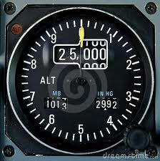
Notes:
An altimeter is an instrument used to measure the altitude of the aircraft above a fixed level. Without this instrument, the pilot would not know how high above the ground he is flying…even on a clear day. Can you appreciate how important this instrument is to a pilot, especially when visibility is impaired?
What faith-instrument do you think we can use to maintain a proper altitude. How about Matthew 6:19 - 21: Lay not up for yourselves treasures upon earth, where moth and rust doth corrupt, and where thieves break through and steal; but lay up for yourselves treasures in heaven, where neither moth nor rust doth corrupt, and where thieves do not break through nor steal. For where your treasure is, there will your heart be also. Let us always strive to live in the heavenlies…at the highest altitude.
NEXT

Slide 9
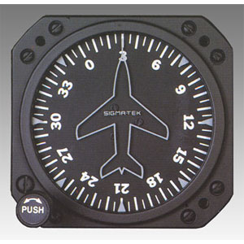
Notes:
Finally there is the the heading indicator (also called an HI)…this is a flight instrument used to inform the pilot of the aircraft's heading. An aircraft's heading is the direction that its nose is pointing. Since there are no roads up in the sky, this instrument is of paramount importance…the heading indicator helps the pilot keep his aircraft on the right road.
What faith instrument can we use to stay on the right course? How about Matthew 6:33: But seek ye first the kingdom of God, and his righteousness; and all these things shall be added unto you. I Timothy 6:11: But thou, O man of God, flee these things; and follow after righteousness, godliness, faith, love, patience, meekness. III John 1:11: Beloved, follow not that which is evil, but that which is good. He that doeth good is of God: but he that doeth evil hath not seen God. I Thessalonians 5:15: See that none render evil for evil unto any man; but ever follow that which is good, both among yourselves, and to all men. Matthew 16:24: Then said Jesus unto his disciples, If any man will come after me, let him deny himself, and take up his cross, and follow me. Hebrews 12:14: Follow peace with all men, and holiness, without which no man shall see the Lord: Let us keep the correct heading.
NEXT

Slide 10
IS FAITH BASED UPON REASON?
Notes:
I once heard an outspoken atheist say, in a tone of distain, these words, “Faith operates outside the bounds of reason.” Do you believe this true or false? Let us examine an excerpt from R2162.
R2162 What, then, is faith? We answer, True faith is the reasonable and accepted conclusion of a logical argument based upon a reasonable premise or foundation.
(REASON: a statement presented in justification or explanation of a belief or action. the mental powers concerned with forming conclusions, judgments, or inferences. a basis or cause, as for some belief, action, fact, event, etc.:)
(REASONABLE: agreeable to reason or sound judgment; logical:)
(LOGIC: reason or sound judgment, as in utterances or actions; the science that investigates the principles governing correct or reliable inference.)
Do you think a pilot could exercise faith in his instruments if that faith was not based upon reason?
R2162 Thus faith is a conviction of things unseen, based on the logical deductions from known facts--a most reasonable thing. What known facts exist that would enable a pilot to fully rely on his flight instruments? How about the fact that they have been tested, proven, measured, and used by other pilots with success, as well as used by himself with repeated success; a very reasonable basis to establish his faith in them.
Observe that in every instance of faith commended in the Bible there was also good ground for faith; there was a clear command of God, a well defined principle of truth and righteousness; and no foolish imaginations or vague impressions were blindly followed. How foolish Noah would have been to spend energy and valuable time in building an ark and warning the people, if he had only imagined that a flood was coming. How culpable Abraham would have been in laying his son on the altar of sacrifice, had he only imagined that God desired him to do so. And how insane Lot would have appeared in hastening out of Sodom that bright morning declaring that the city would be destroyed, had he been given no reliable divine assurance of it.
Actually…It is credulity…which is often mistaken as faith, that operates outside the bounds of reason and is not based upon reason. (Credulity is a willingness to believe or trust too readily, especially without proper or adequate evidence; gullibility.) The difference between faith and credulity is that faith requires, and inquires for, good, sound evidence and authority for its basis. There are people who are very much prejudiced, and who seem to reason very little about anything. Sometimes they are credited with having a great deal of faith, whereas the truth is that they have a great deal of credulity. The faith that is of the responsible kind is that which the Christian is called upon to exercise. He exercises faith in God. On the other hand, credulity is prejudice. The heathen are credulous; for they are blindly prejudiced. Many Christian people seem to be beset by the same spirit of credulity, and seem to mistake it for faith.
NEXT

Slide 11
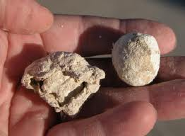
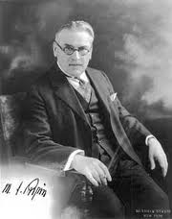
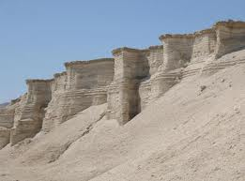
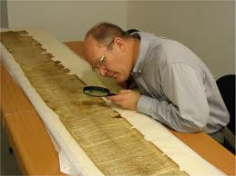
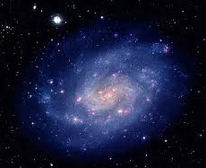
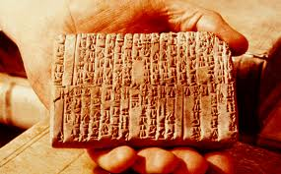
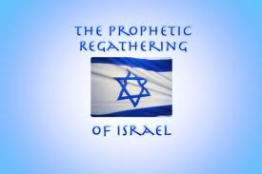
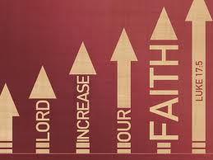
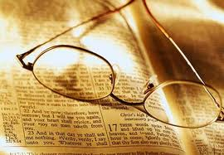
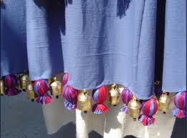
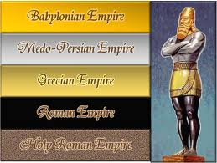
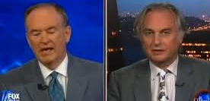
HOW IS FAITH INCREASED?
Notes:
The faith we have at the beginning of our search for the Lord and truth is not the same faith we will have after many years in the narrow way. It will become stronger and more developed as time progresses and as we are trained in the School of Christ. Some of us have begun our search for truth – for God - without any religion or bible…only a consideration and pondering of nature and the universe.
NEXT
When looking at the stars, each moving in its own pathway, or observing a seed growing up after a definite plan into a tree; or watching a baby develop into a full grown, self-directing human individual…it is difficult to conceive of it all taking place as a result of chance. The order of the planets, the succession of the seasons, and of day and night, the growth of vegetation, etc., etc.,-- could not be produced without an intelligent first cause. And so undeniable is the basis of fact thus furnished in nature's testimony, and so logical the reasoning from effect to cause, that the conclusion -- that there is an intelligent, wise and powerful Creator -- is so palpable and irresistible that the Scriptures (Psalms 14:1) declare the man a fool who does not accept it. We read in Psalms 19:2 - 5: Leeser: The heavens relate the glory of God; and the expanse telleth of the works of his hands. Day unto day uttereth speech, and night unto night showeth knowledge. There is no speech, there are no words, their voice is not heard. But their melody extendeth through all the earth, and to the end of the world their words.
Even the most staunch atheists and evolutionists must admit that they have no answer as to how everything began.
NEXT
When interviewing Dr. Richard Dawkins, an evolutionary biologist, author and very outspoken atheist, Bill O’Reilly (The O’Reilly Factor) said to him, when speaking about nature and the universe, “You guys can’t tell me how it all got here,” to which Dr. Dawkins responded by saying, “We’re working on it.”
NEXT
But we find another doctor, Dr. Michael Pupin, who lived from the mid 1800’s to the 1930’s who was quoted as saying, “there is nothing which science has ever found to contradict the thought of a supreme creator. The more science penetrates into the laws of the universe, the more it leads to a belief in an intelligent divinity.”
Having gotten a glimpse of the great Divine Character through the Book of Nature, we properly enough, before exercising faith in the Bible, make inquiry into the personnel of the writers -- who they were, what were their characters, who did they claim to be, what evidences are there that they were true, and do these evidences agree. In other words, faith does not jump at conclusions, but makes investigations and sees that it has some reasonable ground for its existence.
We then begin to make an investigation of the book which is claimed to be the Word of God. Is the Bible the Word of God? NEXT If it is the word of God, then it must, in more ways than one, stand apart from all other books which claim to be divinely inspired. There must be a way in which its claims can be proven. But how can we prove that this is indeed the word of God? Is the Bible any different from the Koran or the Book of Mormon for instance? Upon careful and thoughtful investigation, we do find that the Bible does stand apart from all other religious books…NEXT…we know for a fact that the bible was written over a period of 1600 years, and by many different writers, yet the message is harmonious. It would be impossible for this to be a conspiracy, as a conspiracy could never be upheld for that amount of time. Secondly, the fact that it has withstood all the attacks of its enemies throughout the centuries, yet still survives as the best selling book of all time.
Thirdly, one of the most convincing proofs of the divine inspiration of the Bible is the accurate manner in which its prophecies have been fulfilled. Remember, a prophecy is history foretold. Can the prophecies in the Bible be confirmed? The answer is yes. For starters, let us recall the dream of Nebuchadnezzar recorded in Daniel 2:37-45. Here, Daniel is revealing the meaning of a great image Nebuchadnezzar saw in his dream; an image whose head was of fine gold, his breast and his arms of silver, his belly and his thighs of brass, his legs of iron, his feet part of iron and part of clay.
NEXT
Daniel goes on to explain that the head of gold on the image which the king saw in his dream represented him as the head of the Babylonian Empire. But Daniel said that three other kingdoms would follow. Did this come true? Indeed it did, and to realize the accuracy with which this prophecy was fulfilled should do much to increase our faith in the Bible as the Word of God. History records the fact that Babylon, as represented by the head of gold, was succeeded by the Medo-Persian Empire, which was pictured by the breast and arms of silver. Then came the Grecian world power, which was depicted by the thighs of brass. The Grecian Empire, in turn, was overthrown and succeeded by the Roman Empire, shown by the legs of iron.
And it is interesting to note how the prophecy emphasizes the great strength of the fourth kingdom, the Roman, by calling special attention to the iron legs which foreshadowed it. Daniel said “the fourth kingdom,” which was Rome, “shall be strong as iron.” In its heyday of glory Rome was noted for its great military strength.
NEXT
Then there is the re-gathering of the nation of Israel…a most miraculous event which was prophesied in the Holy Scriptures thousands of years ago…a prophecy fulfilled a little more than 60 years ago. Another evidence that the scriptures are The Word of God; for no man could have ever foretold such an event. We read in Jeremiah 30:3: “For, lo, the days come, saith the LORD, that I will bring again the captivity of my people Israel and Judah, saith the LORD: and I will cause them to return to the land that I gave to their fathers, and they shall possess it.”
Last but certainly not least, the discoveries of archeologists are almost continually confirming the reliability of the Bible. NEXT There have been biblical cities uncovered; confirming records found; NEXT clay tablets uncovered which corroborate the validity of Biblical names, kings and places. NEXT Then there are the Dead Sea scrolls, recognized as the greatest manuscript treasure ever found—the discovery of a group of manuscripts which were a thousand years older than the then-oldest-known Hebrew texts of the Bible (manuscripts supporting the verity of the bible).
And just this past August, 2011, during the excavation of a drainage tunnel under Jerusalem, a worker found a tiny golden bell which could still ring after 2000 years. Can anybody guess where this came from? NEXT From the fringes of a temple priest’s robe -- Exodus 28:34 A golden bell and a pomegranate, a golden bell and a pomegranate, upon the hem of the robe round about. And did you know that brimstone can literally be picked up off of the ground in certain areas around the dead sea. NEXT The same area where Sodom and Gomorrah were located. Genesis 19:24 Then the LORD rained upon Sodom and upon Gomorrah brimstone and fire from the LORD out of heaven.
Now I realize that I don’t need to spend time trying to convince you that the Bible is in fact the Word of God, nor to convince you that there is a Supreme creator, but isn’t it faith strengthening to reviewing such evidences? And we are just touching the tip of the iceberg…we could go on and on stacking up evidence in support of the truthfulness of the scriptures.
NEXT

Slide 12
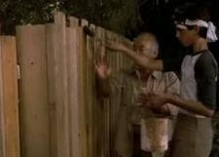
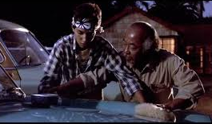
"God is faithful, who will not suffer you to be tempted above that ye are able; but will with the temptation also make a way to escape, that ye may be able to bear it."
1 Corinthians. 10:13
"And “I” will be a Father unto you, and ye shall be My sons and daughters, saith the Lord Almighty.”
2 Corinthians. 6:18
And we know that all things work together for good to them that love God, to them who are the called according to his purpose.
Romans 8:28
Notes:
But now let me ask each of you a question…can each of you exercise the same faith in the Lord when it comes to his dealings in your own life? Do you have the same faith in the promises that he made to you?
Well, let’s see…what did he promise you? For starters, he promised you that all things will work together for your good (as New Creatures). Do you believe him? NEXT Romans 8:28 And we know that all things work together for good to them that love God, to them who are the called according to his purpose. We have the guarantee from the Lord that "all things shall work together for good to those that love God," who put their trust in Him. Whatever would not be a blessing to us will not be permitted. R5546:c2,p6 The well-instructed soul has learned that the good here referred to is not always, nor very often, earthly good, -- temporal advantage: they that love God . . . know that the "all things" include chiefly the trials and disappointments and perplexities and difficulties and temptations of the narrow way, in which they have consecrated themselves to walk; and that the "good" which will be worked out, will be in the chiseled and polished characters, likenesses to the character of Christ, which through faithfulness unto the end will be perfected in the Divine honor and glory. R2241:c2,p5
NEXT
"God is faithful, who will not suffer you to be tempted above that ye are able; but will with the temptation also make a way to escape, that ye may be able to bear it." 1 Cor. 10:13 Our Lord's words respecting the temptations and trials of the Church assure us that this class shall have nothing to fear, that they will be kept, that it will not be possible for them to be tempted, for with every temptation the Lord will provide a way of escape…What we do desire is that each consecrated child of God may see the way of escape which God has provided and may use the same, and thus be in line with the Lord's provision and amongst those shielded ones, the very elect -- "called, chosen, faithful.” R4253:c1,p2,3
Tell of my experience when I prayed for relief from an experience and the relief was granted.
(I’m going to tell on myself)…Talk of my experience when I cried out in complaint and the result.
NEXT
"And (I) will be a Father unto you, and ye shall be My sons and daughters, saith the Lord Almighty." 2 Cor. 6:18 What a promise! What a suggestion! -- that we, by nature defiled and imperfect, should not only have the notice of our sovereign Creator, but should be invited to become His children and be given the assurance of His parental affection for us -- that "like as a father pitieth his children, so the Lord pitieth them that reverence Him." How wonderful it seems! And then, as the Apostle elsewhere declares, this is not the end of the matter, but merely the beginning, for He says, "If children, then heirs, heirs of God, and joint-heirs with Christ, if so be that we suffer with Him, that we may be also glorified together." R5739:c2,p2
"Being confident of this very thing, that He which hath begun a good work in you will perform it until the day of Jesus Christ." Phil. 1:6 Let us not forget that the work is the Lord's, in the sense that His strength supplied to us is vouchsafed to accomplish it, and that He who has begun the good work in us is able to complete it; and He will do so, if we let Him; i.e., if we follow His leading, doing His will. R2124:c1
Or would you respond by saying, “yes, I do believe that all things work together for my good, but I sometimes wonder why my experiences seem to go on for so long; am I a tough nut to crack, am I so hard headed and unable to learn my lessons that the Lord needs them to go on for so long?” My response to this would be…the test of time is what strengthens the faith. Look at any example of faithfulness in the bible and you will find the test of time. Abraham. The Plan of the Ages. Look how long Israel waited for their re-gathering? Look how long the world is waiting for their deliverance…as a matter of fact the test of time has taken its toll on them…they have lost faith in God…haven’t they?
Or maybe you think your experience is strange. Maybe you ask, “How is this good for me”? This experience is causing me to be angry; it’s interfering with my studies or with my family life or my concentration? How can this be good? It’s not helping me, it’s tearing me apart. Have you ever felt that way? Well, If you didn’t have real anger to resist, how would you develop patience? If you didn’t have something needling at you constantly, how would you develop fortitude (synonyms --- courage; resilience; grit; guts; endurance; stamina)? If you didn’t have an experience where you felt as though he wasn’t with you, how would you develop faith in him? (Talk about how I was taught to swim) I Peter 4:12: Beloved, think it not strange concerning the fiery trial which is to try you, as though some strange thing happened unto you:
NEXT
Faith so Tenacious that the Promises Become Living Realities.
Paul reached forward to the things that were before, his faith took hold of the promises of God with such tenacity that to him they were living realities, inspiring zeal and faithfulness. Upon the Heavenly themes he allowed his mind to dwell, as he also advised others, saying, "Whatsoever things are true, honest, just, pure, lovely, of good report, virtuous or praiseworthy, -- think on these things." This is the way he reached forward to the things before; and thus also we must gather our inspiration to holiness and our courage to endurance and persevering faithfulness, even unto death. R1885:c2,p2
Each should cultivate faith in his own heart: (a) By refreshing his memory continually with the Divine promises, becoming very familiar with these in the Father's Word. (b) He should seek more and more to remember that having made his covenant with the Lord these promises are his, and in his heart and with his lips he should claim them as his before the Lord in prayer with thanksgiving. He should claim them as his in his own thoughts, and in his conferences on holy things with the brethren. When trials or difficulties or perplexities arise, he should think of these promises, remembering that they belong to him -- because God has promised them to such as love Him, -- who have made a covenant by self-sacrifice. R2642:c2,p7

Slide 13
WHAT IS FAITH?
WHAT ARE WE TO HAVE FAITH IN?
IS FAITH BASED UPON REASON?
How is faith increased?
Why is faith and obedience so closely related?
HOW IS FAITH DEMONSTRATED?
Notes:
In order to understand this subject better, we are going to examine several questions during the next hour.
NEXT

Slide 14
WHY IS OUR FAITH TRIED?
WHY IS FAITHFULNESS IN SMALL THINGS SO IMPORTANT?
IS FAITH BASED UPON INTELLECT?
What does RomANS 14:22 meaN? "Hast thou faith? have it to thyself before God."
If works cannot save us, then why is faith without works dead?
Notes:
So to begin, we would like to ask, “what is the scriptural definition of faith?”
NEXT

Slide 15
Notes:
Archeology
With the Bible open, the Christian has before him a field of faith-knowledge--knowledge of things not seen by the natural eye--all of which he may continually be proving. While ever satisfied with what he has been demonstrating, he must necessarily be manifesting his faith by the way, proving that which is good. His mental processes being active, he should realize how one feature of the Divine Plan fits into another. Thus his faith grows into larger faith, deeper faith, stronger faith. In time his faith becomes a conviction so strong that he might be willing to stake his life on what he believes to be the truth in the Divine promises. He accepts those promises as something real, something that he knows about--not something received in a vague, unsatisfactory manner. R5892
David’s faith and confidence which enabled him to run to fight Goliath was first developed
R 1788
Enter thou into thy chambers and shut thy doors about thee: hide thyself...until the indignation be overpast." The place of hiding is the secret place of the Most High, under the shadow of the Almighty. (`Psa. 91:1-9`.) This secret place of the Most High, Beloved, is the place of intimate communion and fellowship with God, through the blessed privilege of prayer and through faith in his precious Word and his promised providential care. When all around our souls give way, He then is all our hope and stay.”
Oh, how precious is this hiding place! What rest and refreshment we find in the midst of the commotion that is even now bestirring the whole world, but especially the nations of Christendom--rest from the pride and folly of man in their abortive efforts to readjust the present unsatisfactory social order; and rest from the strife of tongues in an equally vain attempt to evolve the clear principles of truth and righteousness from the present confusion of human traditions.
(`Psa. 31:20`.) Here we find rest, peace, light and joy, which the world can neither give nor take away. Few indeed are those who can understand our motives in thus withdrawing from the world and from the various organizations of the nominal Christian church to walk alone with God; and many are the reproaches which such must endure for his name's sake. But fear not; "shut thy doors [of faith] about thee," and heed not the reproaches; turn a deaf ear to them, and "Sanctify the Lord of hosts himself, and let him be your fear, and let him be your dread" (`Isa. 8:13`); and, "Above all, take [for the conflict before you] the shield of faith, wherewith ye shall be able to quench all the fiery darts of the wicked.” R 1788

